Slide 1

South Orange
Water Utility Sale
COMMUNITY MEETING
WEDNESDAY, OCTOBER 11, 2024

Slide 2
PANELISTS
South Orange Village
Sheena Collum, Mayor
Douglas Newman, Chair, Water Utility Task Force (unable to attend)
Julie Doran, Village Administrator
Howard Levison, Water Administrator
Chris Battaglia, CFO
Clyde Otis, Village Attorney
New Jersey American Water Representatives

Slide 3
COMMUNITY MEETING AGENDA
What prompted considering selling the Village’s water utility?
Why have this community meeting?
About South Orange’s Water Utility
  Infrastructure
  Water supply
  Operations & maintenance
  Finances
  Capital improvement plan
Background and process
NJ American Water proposal
Recommendation to the community
NJAW introductions & company background
Questions

Slide 4
WHAT PROMPTED CONSIDERING
SELLING THE VILLAGE’S WATER UTILITY?
Cost and financial impact of state-mandated identification and replacement of lead/galvanized lines and direct costs to property owners.
Long-term utility debt, currently $18.3M, coupled with Capital Improvement Plan (CIP) to address aging infrastructure requires additional ~$50 million investment over next 10 years.
New Jersey American Water (NJAW) indicated it won’t provide Operations and Maintenance (O&M) services after its agreement expires mid-2026.
Village anticipates cost increases to its bulk water purchased from NJAW, due to stricter environmental and testing regulation.

Slide 5
WHY HAVE THIS COMMUNITY MEETING?
After a 2+ year, extensive review, South Orange’s Village Council adopted Ordinance #2024-15 to advance the sale of Village’s water system – subject to a public referendum/vote.
In November’s general election, South Orange voters will be asked:
    “Shall South Orange Village, in the County of Essex, New Jersey, be authorized to sell its water distribution and transmission system (commonly known as the “System”) to New Jersey American Water Company Inc. for the sum of $19,700,000?” __ Yes / __ No
This community forum will provide an in-depth look at the process, analysis, and ultimate recommendation, asking voters to approve the sale.

Slide 6
ABOUT SOUTH ORANGE’S WATER UTILITY

Slide 7
SOUTH ORANGE WATER UTILITY
  History
  Infrastructure
  Water supply
  Operations & maintenance
  Finances
  Capital improvement plan

Slide 8
HISTORY: A bit of quick history
The origin of the South Orange Water Utility goes back to the late 1800’s where the source of water came from a series of wells along the river that was then piped back to a pumping station located in the current DPW yard.
Around 1914 the system was further developed with the construction of an underground Storage Reservoir at the western end of South Orange Avenue having a capacity of 2 million gallons providing both storage and pressure to what is called the low Pressure Zone (eastern section of the Village) and a pumping station that pumped water to what is called the High Pressure Zone.
An additional Storage tank was constructed on Crest Drive to provide storage and pressure to the High Zone. As Newstead area was developed another tank – a Water Sphere was constructed provided storage and pressure to what is called the Mountain Zone.
The current Reservoir is the original whereas the Crest Storage Tank has been replaced in the 1950’s proving greater capacity. All three storage facilities are in dire need of either repair and in the case of the Crest Dive tank, replacement.
The system had been staffed and maintained by our internal staff.

Slide 9
HISTORY: A bit of quick history
Some time in the 70-80’s the well field was contaminated requiring the Village to seek an alternative water supply. East Orange Water was selected to provide both water supply and the Operations and Maintenance (O&M) under a 25 year contract. Some significant issues occurred toward the end of the contract, around 2015 that lead the Village to not renew and find an alternative. NJAW was selected under two contracts one for the supply of water – 30 years with multiple renewals and the other for Operations and Maintenance on a 10 year basis that is currently running out in about one and half years that NJAW has indicated they will not renew thus putting us in the current situation.
Infrastructure components include 72 miles of underground piping (mains) varying in size, material and age installed from the 1890’s to today (Scotland Road and shortly West End Road) from a size of 4“ thru 12” in diameter made of Cast Iron (CI), Ductile Iron (DI), Asbestos Cement (AS) that was used during WWII and a minor amount of plastic and galvanized. We are mandated by the DEP to replace aging pipe – called the 150 year rule.
Residential Service Connections are from the main in the roadway to the curb at a curb box (shut off valve) then to the residence where it is connected to a meter and then to the home distribution.
Infrastructure component replacements are planned through results of annual inspections and exercise, emergency situations and our Capital Improvement program that meet our planned strategic design criteria of reliability, redundancy and resiliency objectives.

Slide 10
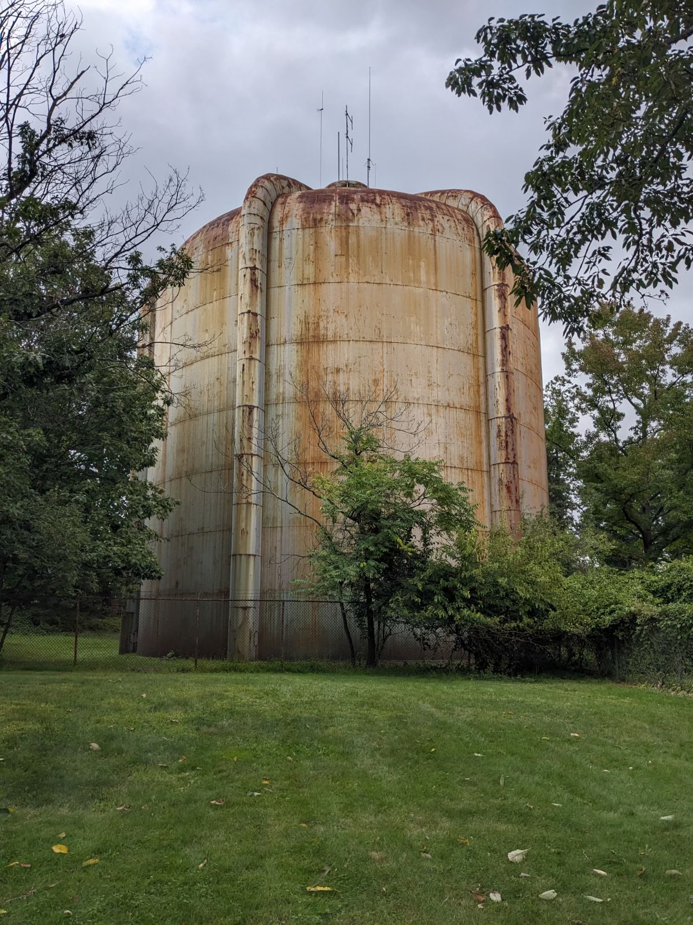
INFRASTRUCTURE
5,000 service locations
3,000 water valves
600 fire hydrants
75 miles water mains (oldest early 1900’s)
3 water storage facilities (3.7M gallons)
  Main reservoir (1912) – South Orange Ave
  Standpipe (1950’s) – Newstead
  Water sphere (1952) – Newstead
3 pressure zones – controlled by pumping stations & supplied by storage facilities
  Low-pressure zone
  High-pressure zone
  Mountain zone

Slide 11
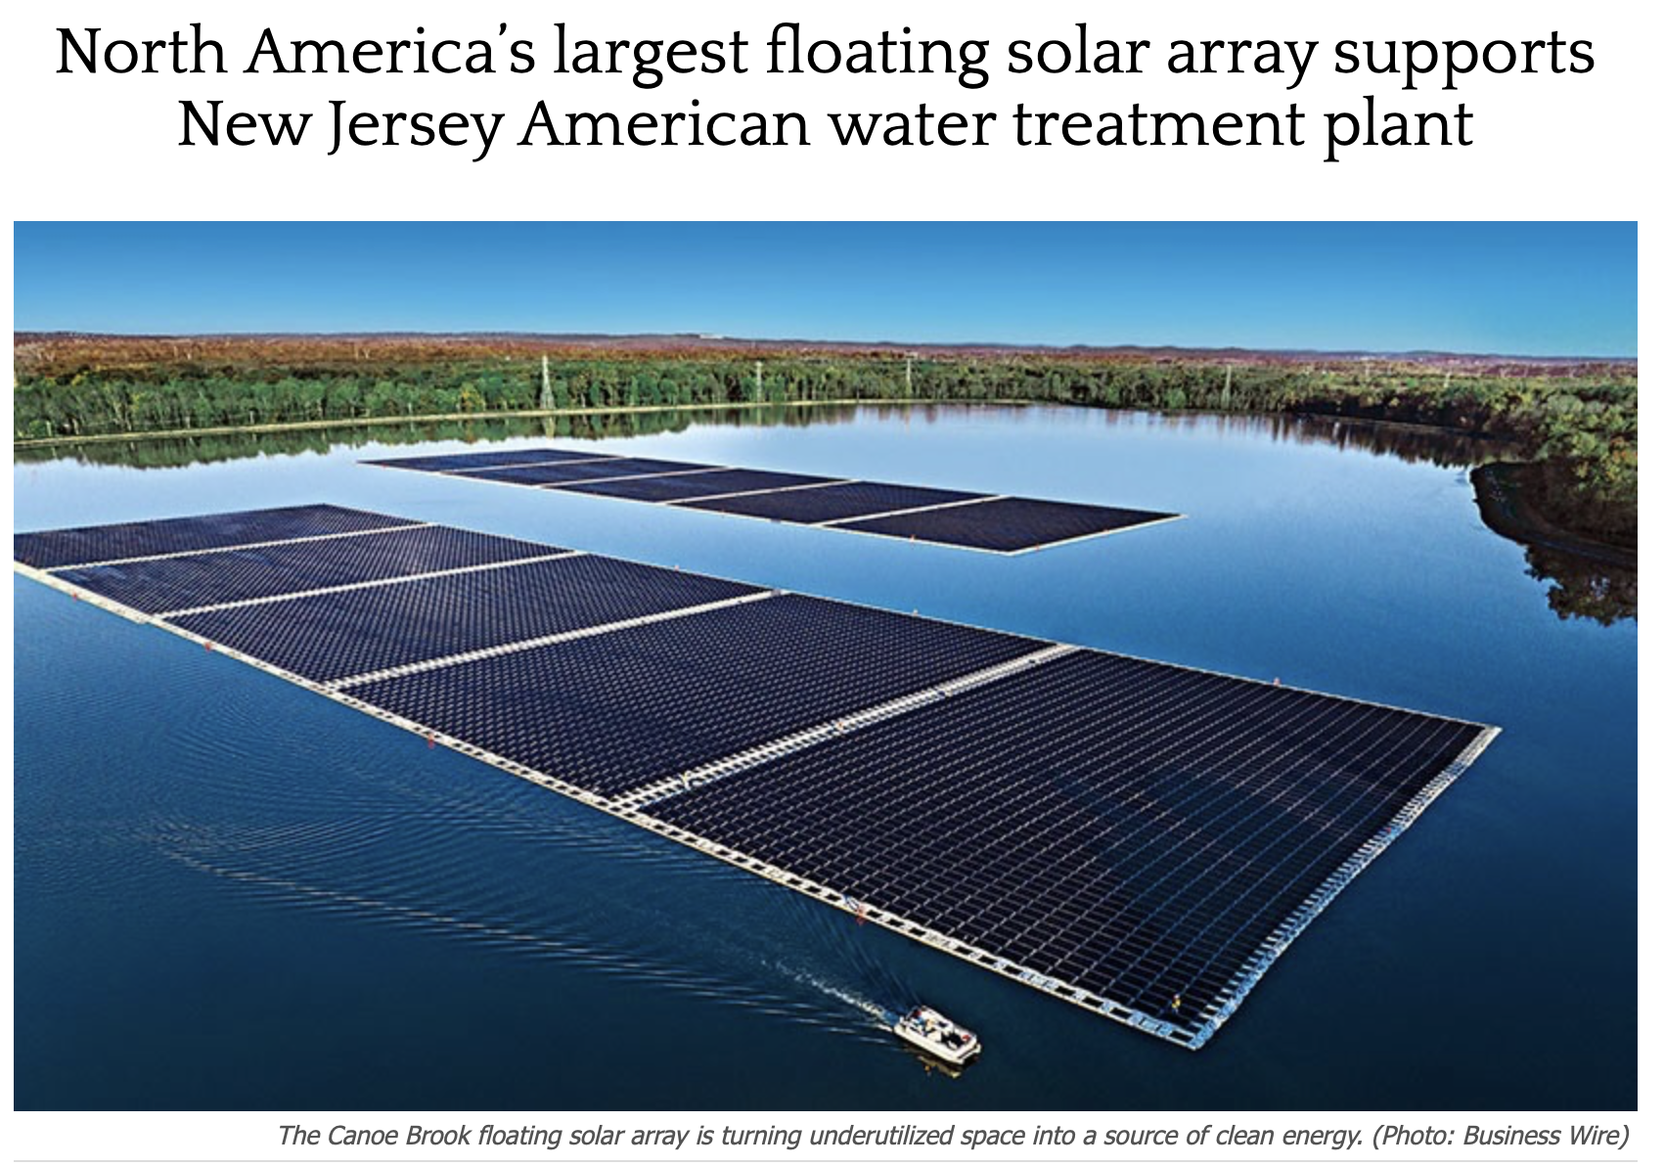
WATER SUPPLY
The Village does not have its own water supply; the majority of the Village water has been purchased for almost 30 years.
Purchased from NJAW since 2017, based on rates set by NJ Board of Public Utilities.
Water treated at NJAW’s state-of-the-art Millburn facility, regulated by NJ Department of Environmental Protection (DEP).

Slide 12
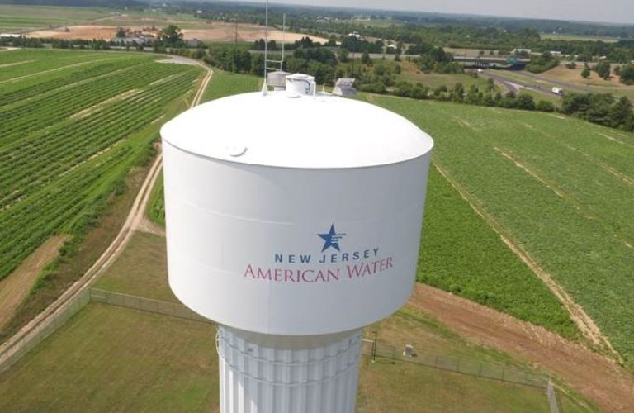

OPERATIONS & MAINTENANCE (cont’d)
Since 2016
    In 2016, the Village terminated EOWC contract
    The Village engaged NJAW to provide bulk water supply (up to 60 years) and all O&M (10 years)
    Village outsources infrastructure engineering, repairs, replacements, and work
    Village employees
      Part-time water utility administrator
      Share of other employees’ time (1.25 FTE)
    Village Council approves water rates and Capital Improvement Plans (CIP)
PLACEHOLDER

Slide 13
FINANCES
Self-liquidating rate structure ➔ rates set annually to cover expenses. As expenses (including debt service) increase, rates must increase.
$5.67 million revenue
$5.24 million expense
  $4,184K operations & maintenance (79.9%)
  $895K debt service (17.1%)
  $144K salary & wages (2.7%)
  $16K statutory expense (0.3%)
$0.43 million surplus
$18.3 million debt

Slide 14
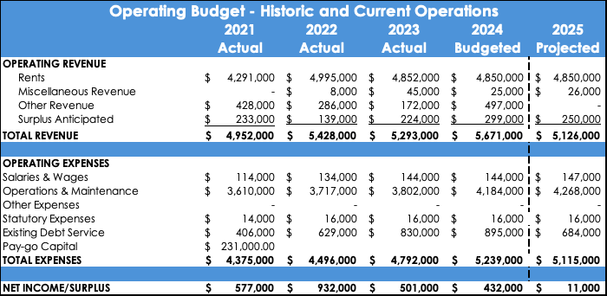
FINANCES (cont’d)

Slide 15
CAPITAL IMPROVEMENT PLAN
Near-term $14.25 million; long-term (10 years) $50 million
$6.5M Crest Drive Standpipe replacement & infrastructure upgrades
$2.0M Lead Line identification & replacement
$1.5M Newstead/Brentwood Water Tank rehabilitation
$1.5M Infrastructure upgrades
$1.5M Water Main replacements
$1.25M Capital Improvements & Repair/Replacements (CIRR)

Slide 16
BACKGROUND AND PROCESS

Slide 17
PROCESS & TIMELINE
November 2021 – System valuation completed and provided to Village Council.
September 2022 – S.O. Water Utility Task Force established (Resolution #2022-VP04) with elected officials, employees, and community volunteers
    “…evaluate the most efficient and cost-effective structure to deliver high-quality and safe water to the residents and stakeholders in South Orange and, in performing that evaluation, to consider (without limitation) capital investments, consequential water rate(s), staffing, operations, maintenance, alternative ownership structures and potential sale of the utility to a private regulated utility”
November 2023 – Task Force issued its ‘Report of Findings’ to Village Council
March 2024 – Village Council adopted Resolution #2024-096: “Resolution Deeming It Advisable to Consider the Sale of the South Orange Water Utility and System and Authorizing Advertisement for Bids for the Sale of Same.”
Note: Winter 2022 to now, Village apprised residents about ongoing process – through quarterly Gaslight newsletter (mailed to every home), Village website, press releases, and Village Council meetings.

Slide 18
PROCESS & TIMELINE (cont’d)
June 2024 – Bids received from two, major regulated water companies
  Veolia: $12.5M + additional considerations
  NJAW: $19.7M + additional considerations
July 2024 – Village Council adopted Ordinance #2024-15: “An ordinance of South Orange Village Advancing the Sale of the Village’s Water System and Authorizing a Proposal to be Printed on the Ballot for Consideration by the Voters within the Village at the General Election on November 5, 2024
September-October 2024 – Community meetings and public education
November 5, 2024 – General Election referendum
Note: Winter 2022 to now, Village apprised residents about ongoing process – through quarterly Gaslight newsletter (mailed to every home), Village website, press releases, and Village Council meetings.

Slide 19
WATER UTILITY TASK FORCE’S FINDINGS
Task Force’s investigation supported by Remington & Vernick Engineers' Water & Wastewater Division – retain vs. sell water system
Option 1: Retain Village ownership scenarios – assumed NJAW continues supplying water under long-term agreement, at least through 2075
  Scenario 1: Continue outsourcing O&M to third party
  Scenario 2: Provide in-house O&M with Village personnel
  Scenario 3: Hybrid using Village personnel and third-party contractors
Option 2: Sell the system to regulated, third-party provider
  Researched regulatory process
    Voter referendum or
    Water Infrastructure Protection Act
  Researched experience of other New Jersey municipalities – recent sales & adjacent communities
  Held informal discussions with regulated water companies
Notes:
I’d like to take a moment to talk about the findings of the task force. Took a deep dive into the assignment. Their work was supported supported by the RVE analysis and worked to understand the financial and regulatory implications, interviewed other communities who have sold their utilities and
Option 1 Scenario 1 lots of variability meter reading, billing, examples but finding a licensed system operator is a difficult position to fill, especially for a smaller municipality.
Option 2: 2 options VC decided to pursue the referendum option

Slide 20
NJAW PROPOSAL

Slide 21
PROPOSAL OVERVIEW
$19.7 million purchase price – eliminate all water utility debt ($18.3M) and ~$1.4M general municipal debt
Infrastructure investment – $50 million over 10 years; $35 million in first five years
Lead line replacement – full compliance with identification & comprehensive replacement on both utility and customer side
Rate predictability – phased-in increases totaling 9% over first five years (vs. historically 5% annually in South Orange)
  Years 1-2: no increases
  Years 3-5: 3% increases
  Years 6-15: rates eventually converge with NJAW statewide rates
  NJ BPU regulates all rates and changes

Slide 22
REFERENDUM CONSIDERATIONS
General Election: November 5, 2024
‘Yes’ vote = sell
  Investment – $69.7 million = $19.7M purchase + $50M upgrades
  Purchase price statutorily required to eliminate water utility debt; excess then applied to reduce municipal debt
  Lead line replacement – comprehensive and timely; cost allocated across NJAW’s entire customer base
  Rate stability – predictable and regulated rate increases; only 9% in initial five years, then converging with rates in adjacent municipalities
  Infrastructure improvements – modernized and upgraded water system
  Water-related Village properties converted taxable ratables
  Similar to West Orange, Maplewood, Millburn, and Irvington
  ‘No’ vote = retain ownership
  Projected rate increase – 74% over next 5 years
  Capital improvements – major investments required to maintain & upgrade
  Identify new, qualified O&M provider or increase staffing by ~12 employees

Slide 23
RETAINED WATER UTILITY BUDGET PROJECTION

Slide 24
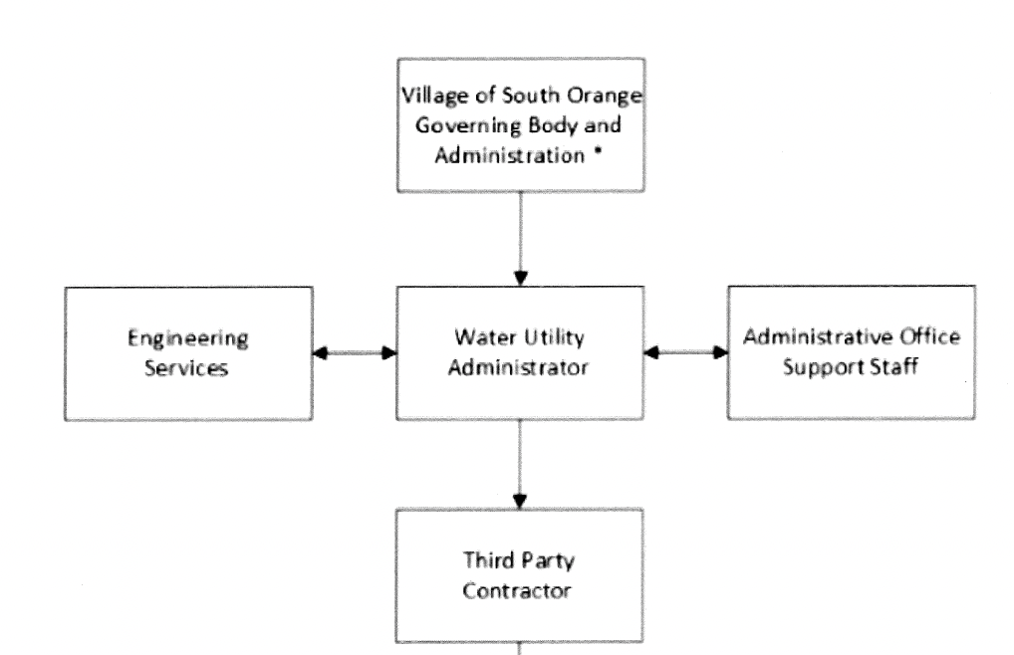
MUNICIPAL ASSUMPTIONS
Option 1; Scenario 1 (If Retained: Most likely)
Water Comes from NJAW
Outsource O&M
  2026 RFP
  SOV Water Utility Staffing
    New Costs: Year 1 & 2 ($605,000), Year 3+ ($498,750)
  1 FT Executive Director, Staff Engineer, Administrative Assistant (Billing, Communications, Customer Service, etc.)
  Year 1 & 2 only: Consulting Engineers
Operating Expenses
  - New Costs: $54,000 for Office Space/Professional Services, IT & Software
Capital Improvement Plan
  $50M regardless of scenario or option
NEW SLIDE
NEW SLIDE

Slide 25
MUNICIPAL ASSUMPTIONS
Option 1; Scenario 2 (If Retained: Not Likely)
  Water Comes from NJAW
  Provide In House O&M & terminate 3rd Party Contract
  SOV Water Utility Staffing
  $1.65M in Personnel
Operating Expenses
  $3.94M
Capital Improvement Plan
  $50M regardless of scenario or option
NEW SLIDE
NEW SLIDE

Slide 26
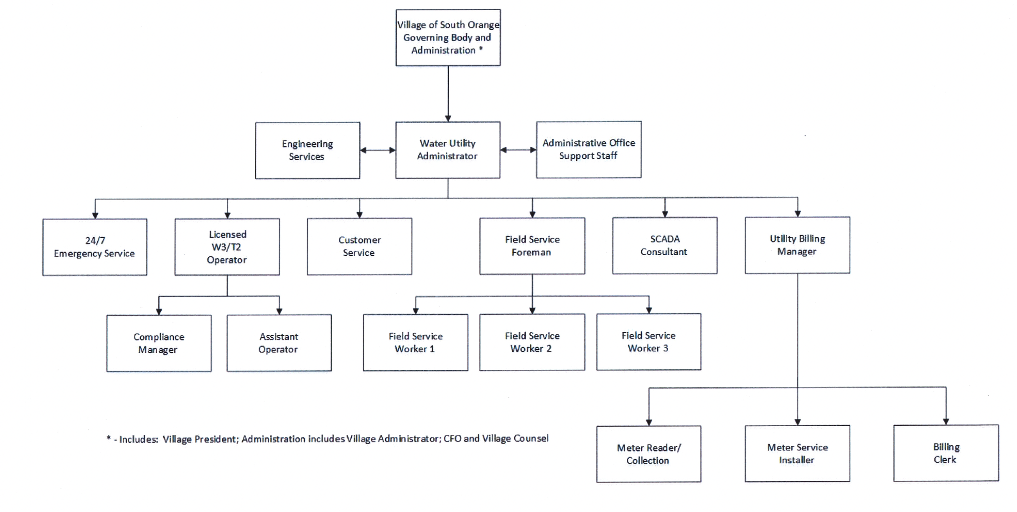
MUNICIPAL ASSUMPTIONS
Option 1; Scenario 2 Staffing Sample
(If Retained: Not Likely)
NEW SLIDE
NEW SLIDE

Slide 27
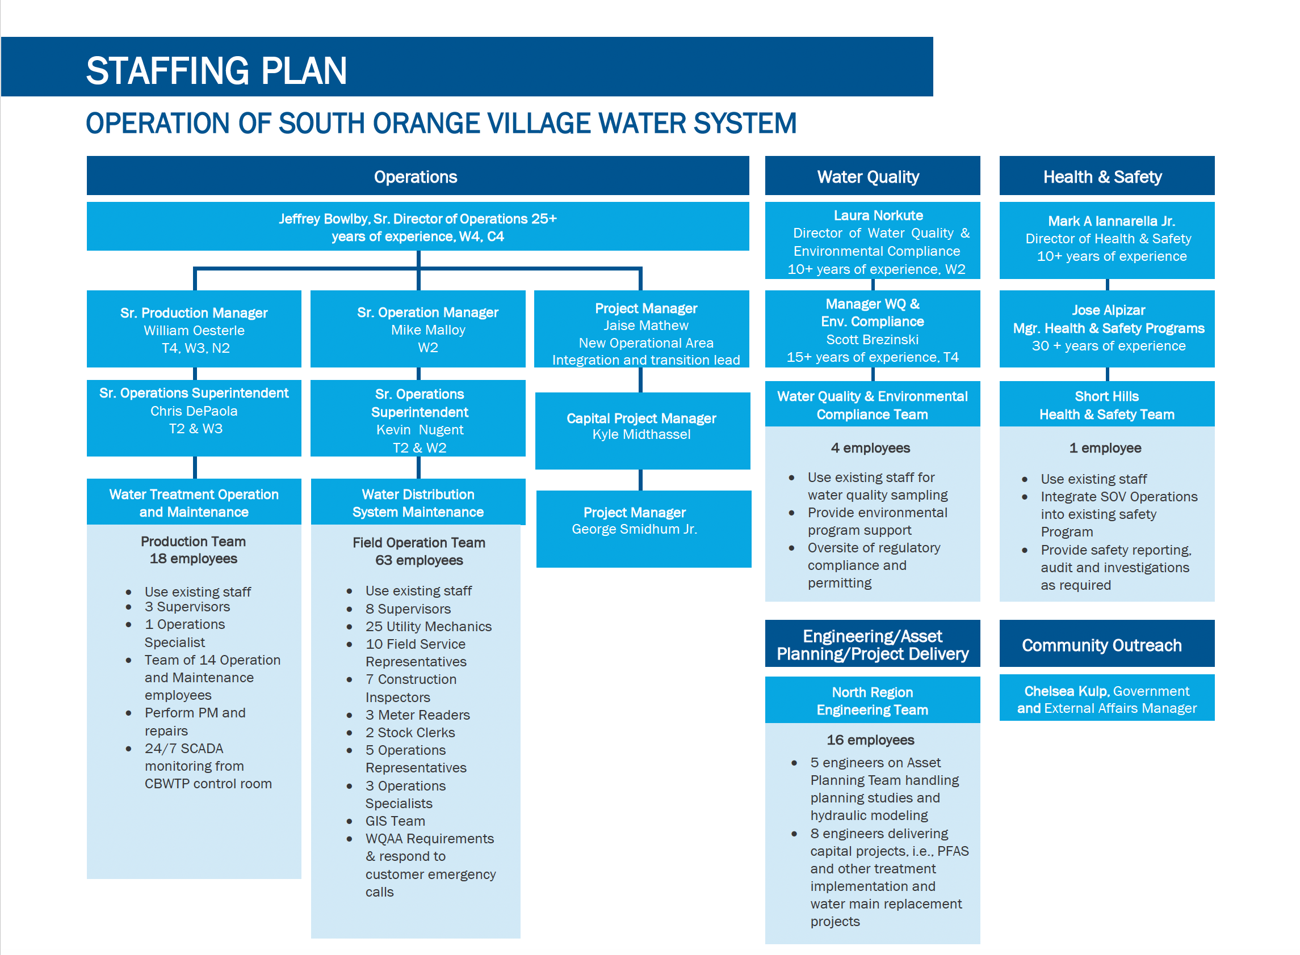
MUNICIPAL ASSUMPTIONS
Option 2: Staffing (If Sold to NJAW)
NEW SLIDE
NEW SLIDE

Slide 28
WATER RATE PROJECTION
NJAW Cost in NJ
*The average South Orange customer uses 9,000 gallons of water per month. After a six-year set-rate schedule, NJAW would slowly increase the South Orange Village rate to match the NJAW rate.

Slide 29
EXHIBITS

Slide 30
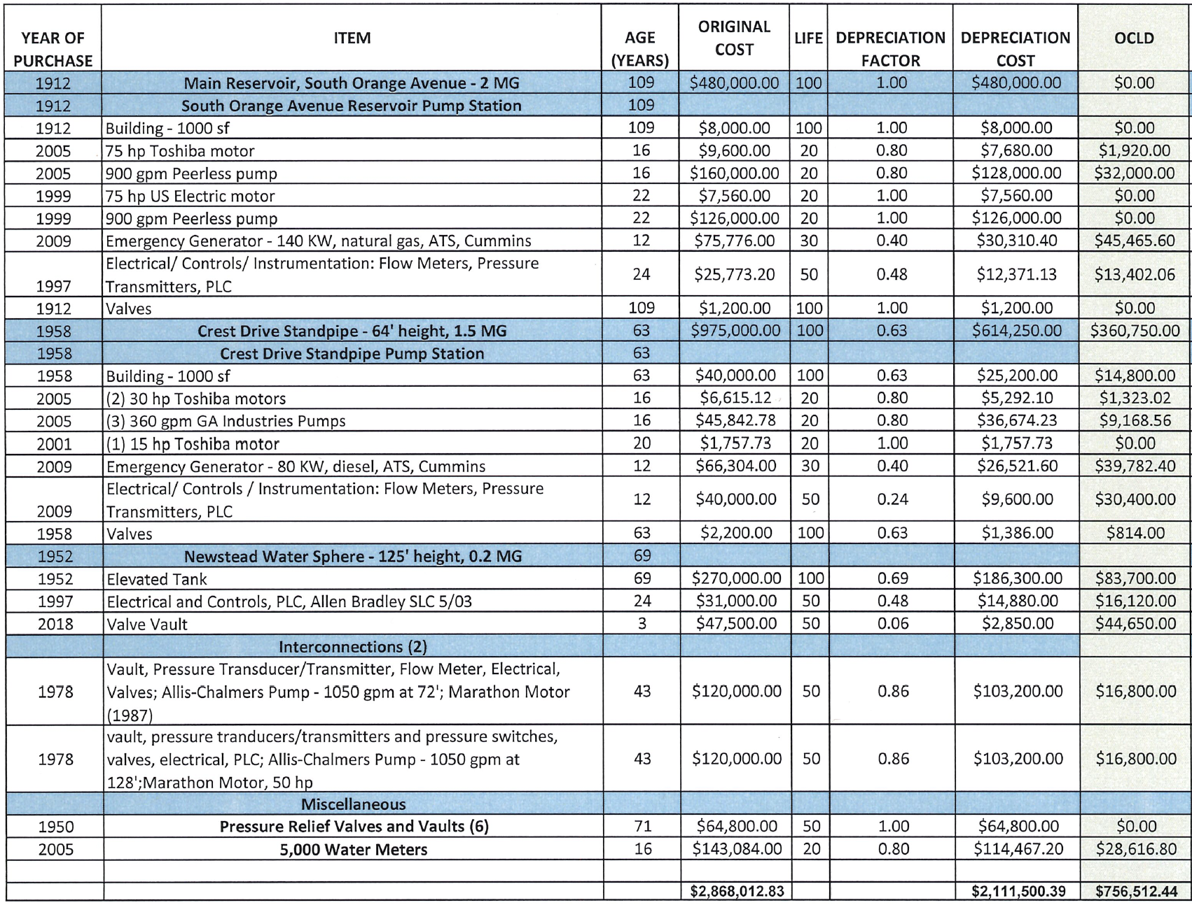
Exhibit 1A: WATER SYSTEM FACILITIES INVENTORY

Slide 31
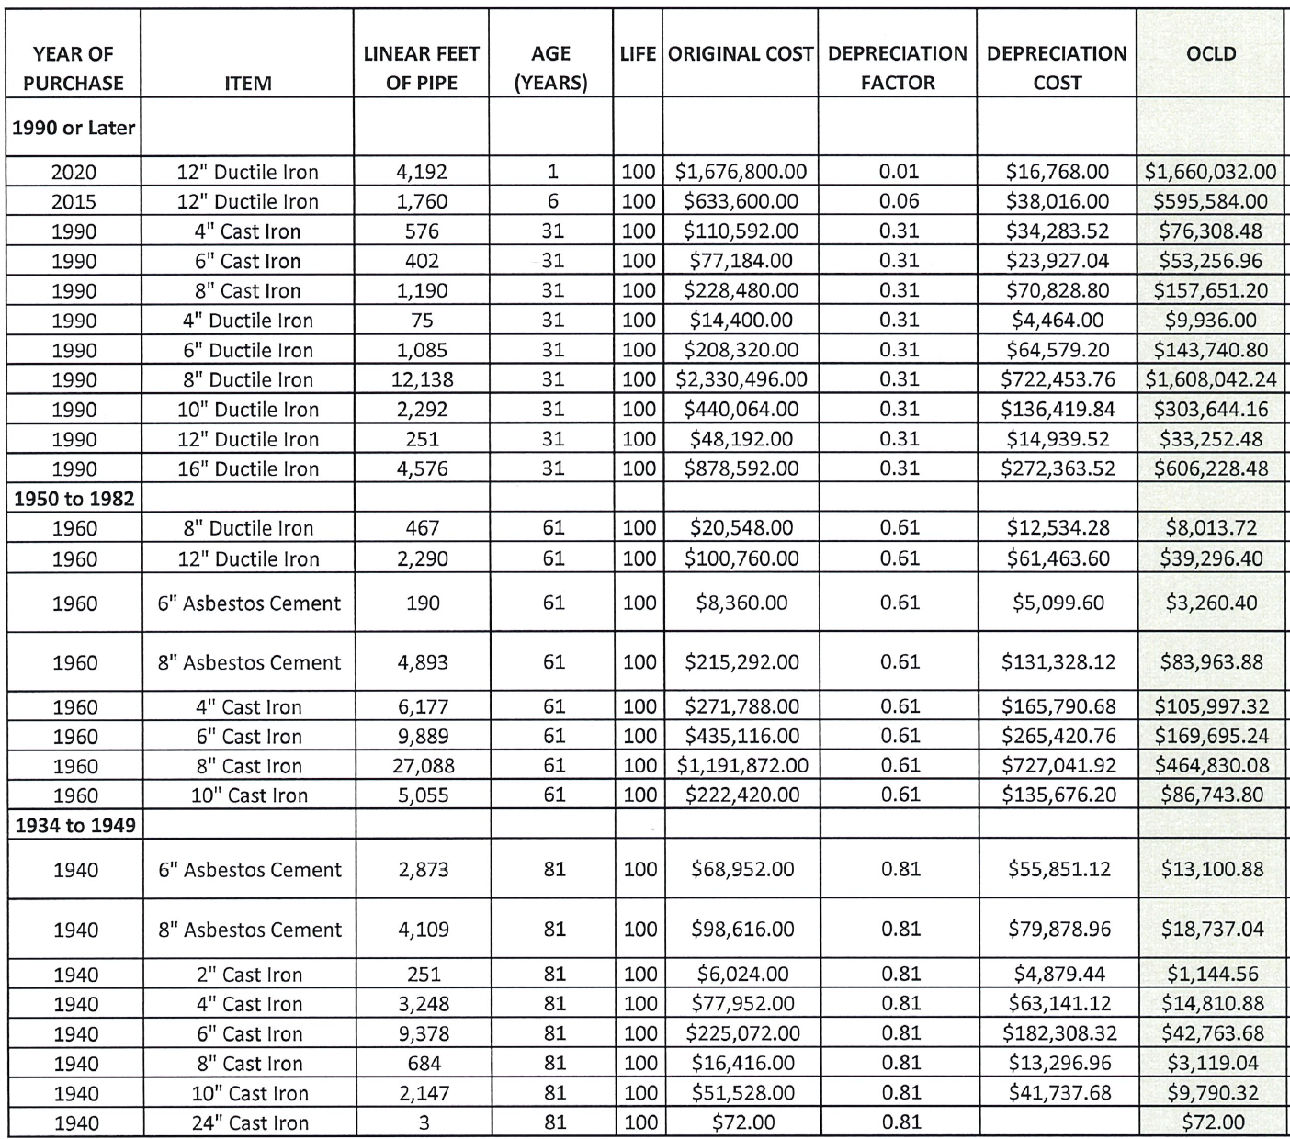
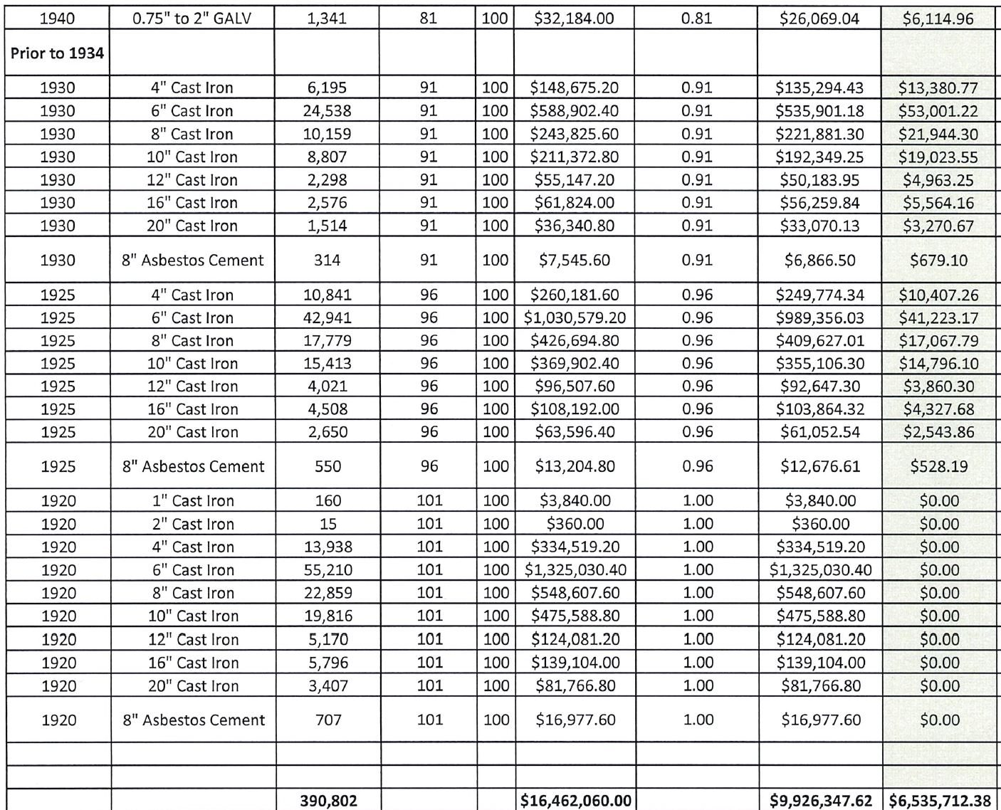
Exhibit 1B: WATER SYSTEM WATER MAINS INVENTORY

Slide 32
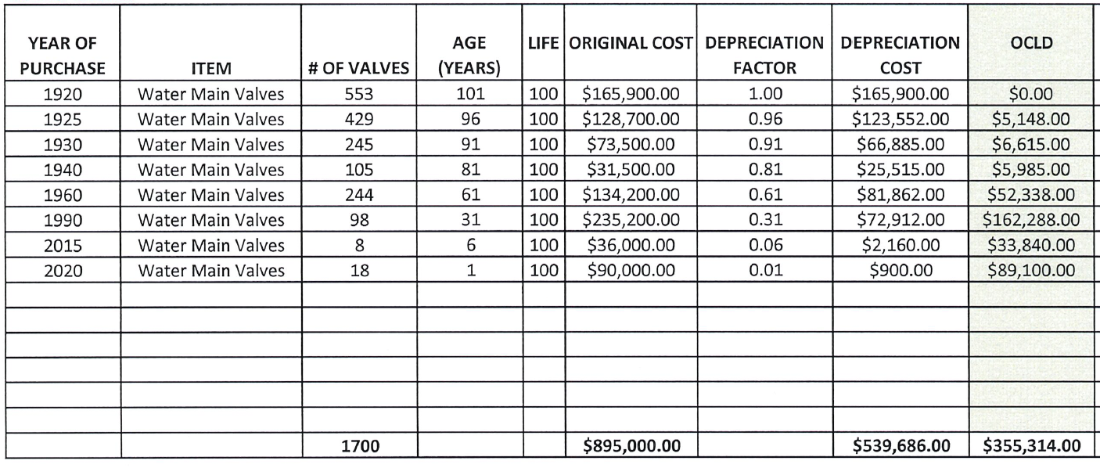
Exhibit 1C: WATER SYSTEM MAIN VALVES INVENTORY
Valves

Slide 33
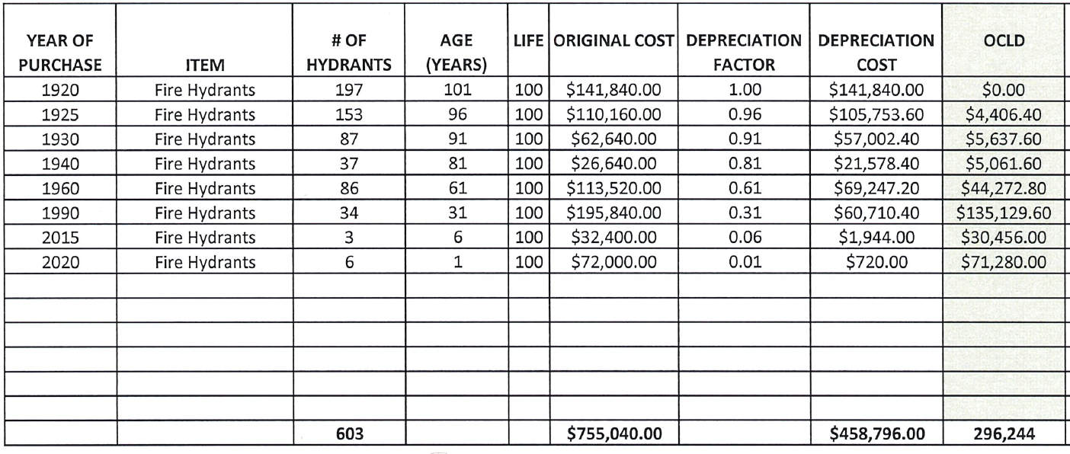
Exhibit 1D: WATER SYSTEM FIRE HYDRANT INVENTORY

Slide 34
RECOMMENDATION TO VOTERS
VOTE YES

