Slide 1

Board of Health Presentation
January 26, 2026

Slide 2
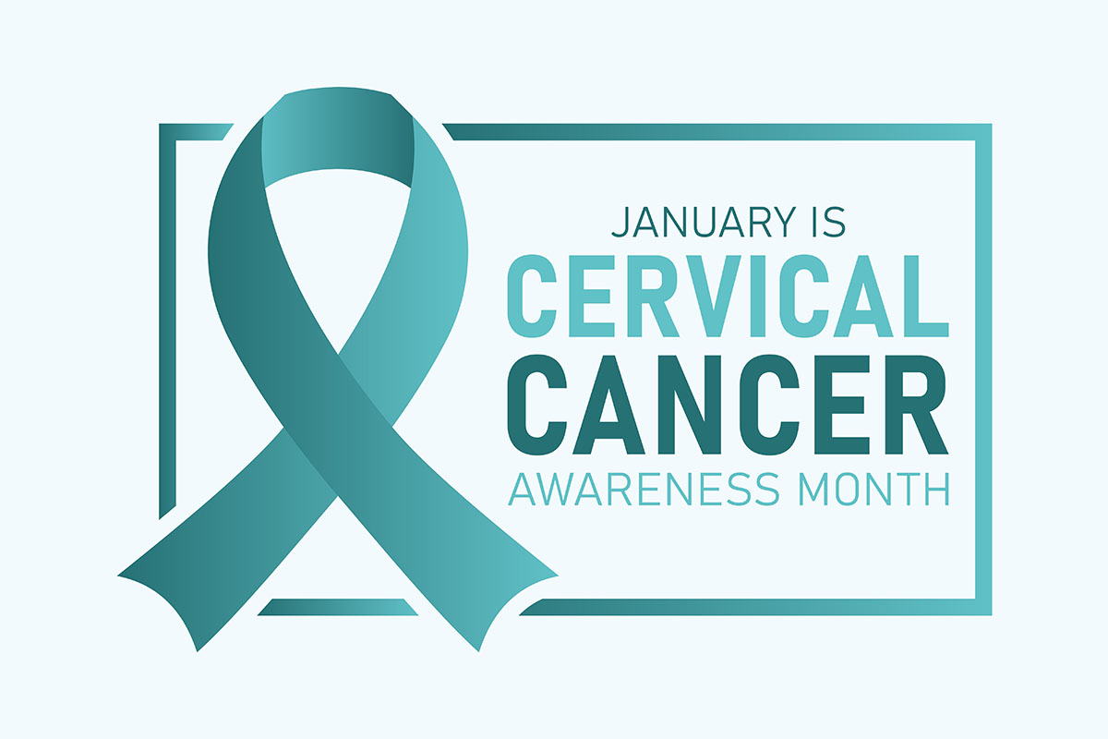
13,000 women in the U.S. are diagnosed with cervical cancer each year
More than 4,000 of women will die.
*However it is one of the most preventable types of cancers, with regular screening.
Prevention:
HPV vaccination
Cervical Pap and HPV tests
https://www.nccc-online.org/cervical-cancer-screening/
Notes:
More than 13,000 women in the United States are diagnosed with cervical cancer each year, and more than 4,000 of women will die. Cervical cancer is the fourth most common type of cancer for women worldwide. Because it develops over time, it is also one of the most preventable types of cancer.
Cervical cancer tends to occur during midlife. It is most frequently diagnosed in women between the ages of 35 and 44. It rarely affects women under age 20, and more than 15 percent of diagnoses are made in women older than 65. But in women over 65, cancer typically occurs in women who were not receiving regular screening.
Human papillomavirus (HPV) causes more than 99% of cervical cancers.
Current guidelines for cervical cancer screening are:
Women should start screening with the Pap test at age 21. (Screening is not recommended for women under age 21.)
Starting at age 30, women have three options available for screening:
A Pap test alone every three years
Co-testing with a Pap and HPV test, every five years
An HPV test alone, every five years
Depending on the results of the Pap and/or HPV tests, a healthcare provider may recommend additional screening or procedures, so some women may be screened more often.
the exact test or tests used is not as important as simply being screened regularly!
After age 65, women older than 65 who have had adequate prior screening and are not otherwise at high risk can stop screening. Women who have had a hysterectomy (with removal of the cervix) also do not need to be screened, unless they have a have a history of a high-grade precancerous lesions.
Source: https://www.nccc-online.org/cervical-cancer-screening/ National Cervical Cancer Coalition

Slide 3

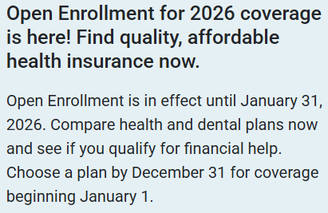

https://njfamilycare.dhs.state.nj.us/
https://www.nj.gov/getcoverednj/
Notes:
https://www.nj.gov/getcoverednj/
https://njfamilycare.dhs.state.nj.us/

Slide 4
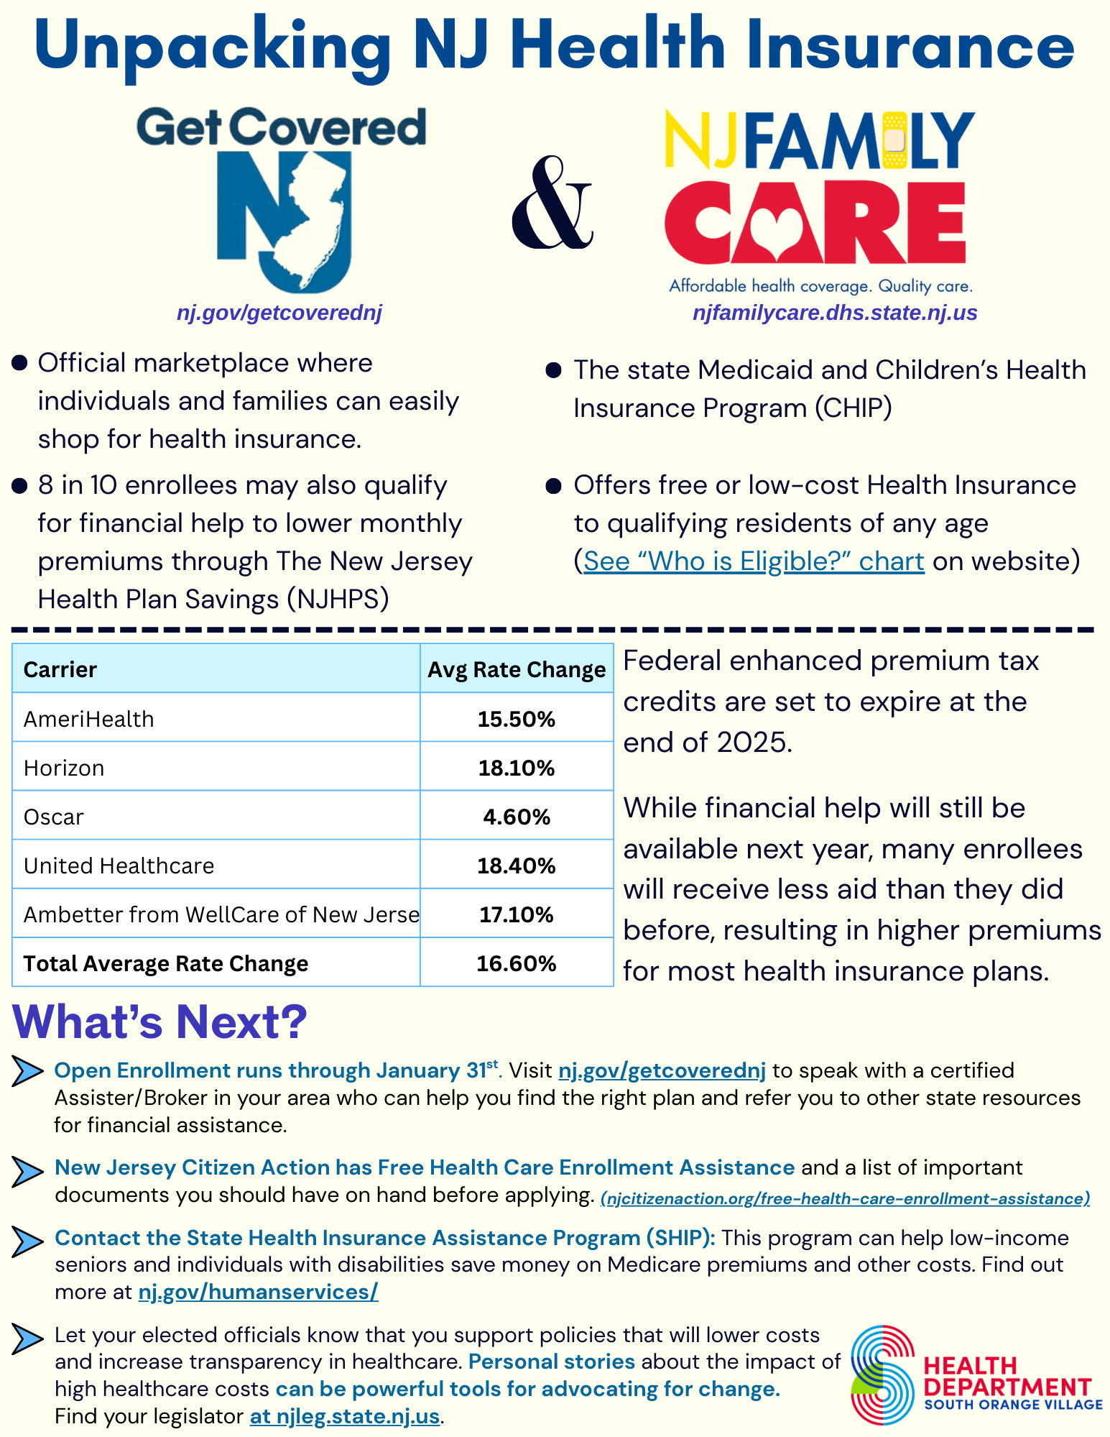
South Orange Health Deparment
https://www.southorange.org/167/Health-and-Animal-Control
Notes:
Full PDF Available on our Health Dept homepage online

Slide 5

Nursing Update

Slide 6
Nursing Report - December
Reportable Diseases Investigated: 5
Cases Closed: 4
Current Cases Open = 1
Health Screenings = 3
Notes:
HEPATITIS C – ACUTE CONFIRMED

Slide 7
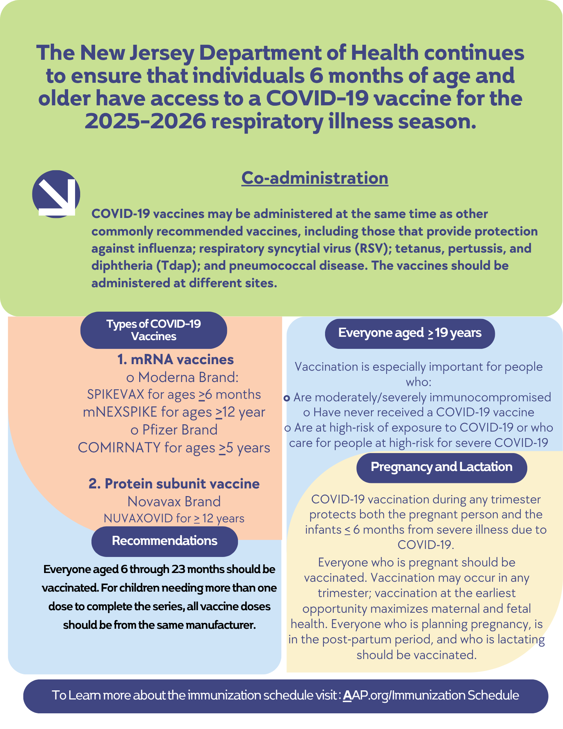

Slide 8
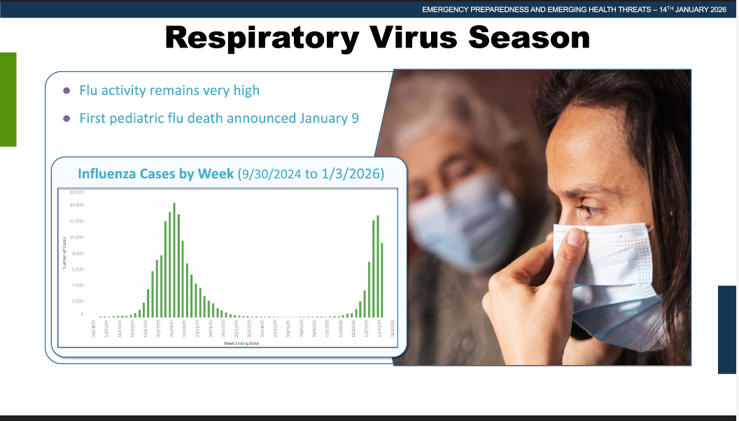

Slide 9
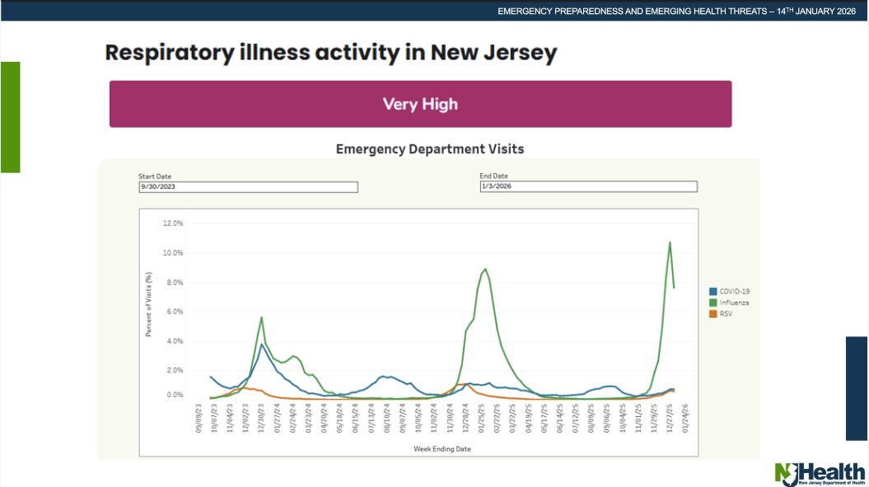
Notes:
Data reporting period 9/30/2023 to 1/03/2026

Slide 10
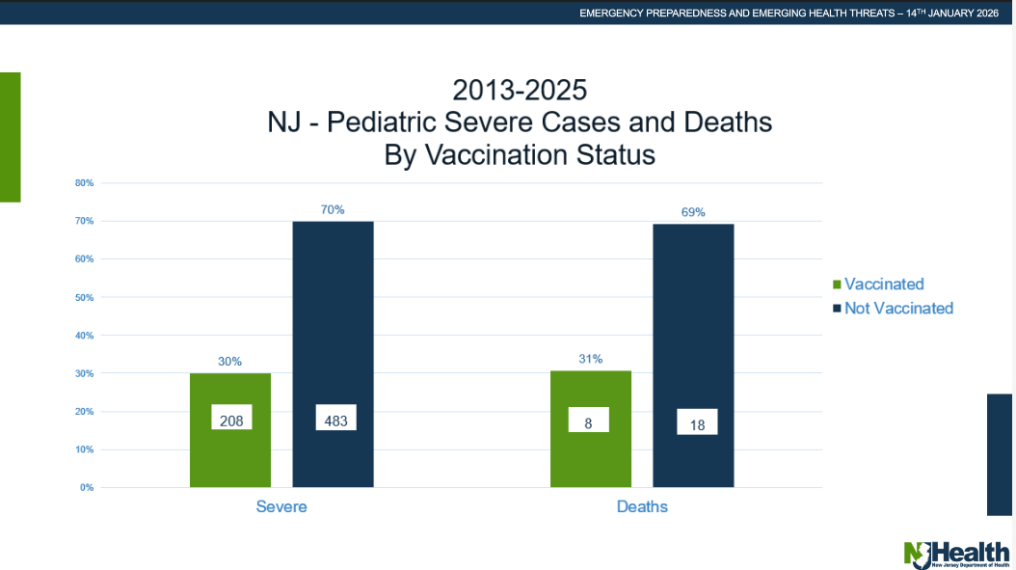

Slide 11
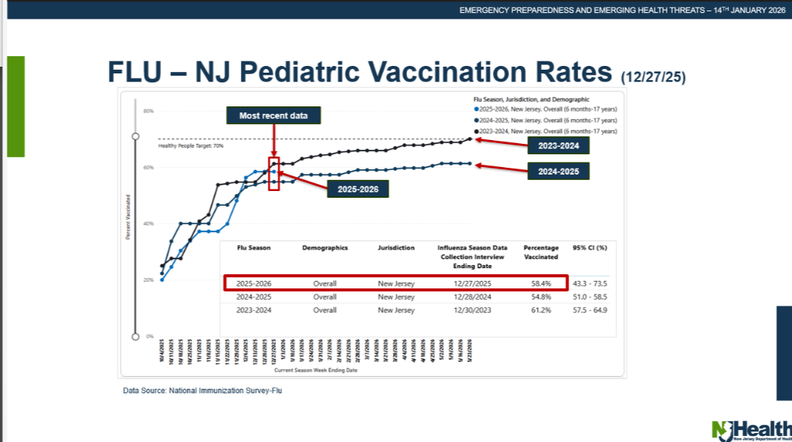

Slide 12
Environmental Health Update

Slide 13
Environmental Health - December
Health Department Licenses:
Retail Food Establishments (Restaurants)
One Day Food Licenses (events/ festivals)
Vape Shops
Recreational Bathing (Pools)
Dogs, Cats and Chickens
Inspections
Restaurant inspections: 7
Pre-operation inspections: -
Re-inspections: 1
Mobile Food Trucks: -
Animal Bites: 2
Notes:
- Animal bites are from our records not including animal control involved.

Slide 14

Animal Control Update

Slide 15
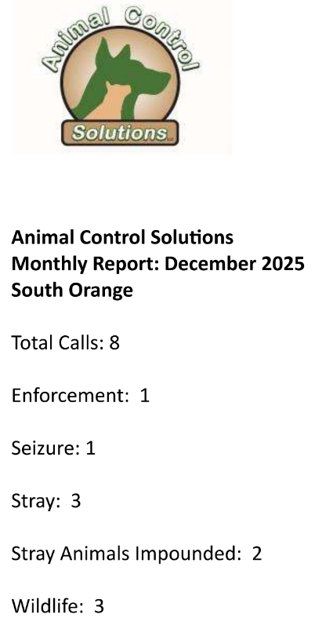
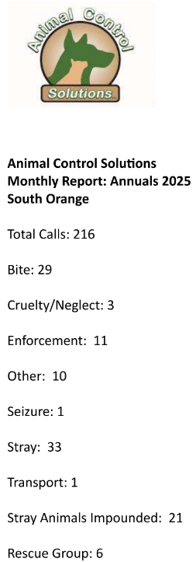
December
2025 Overview
Notes:
Did not send

Slide 16
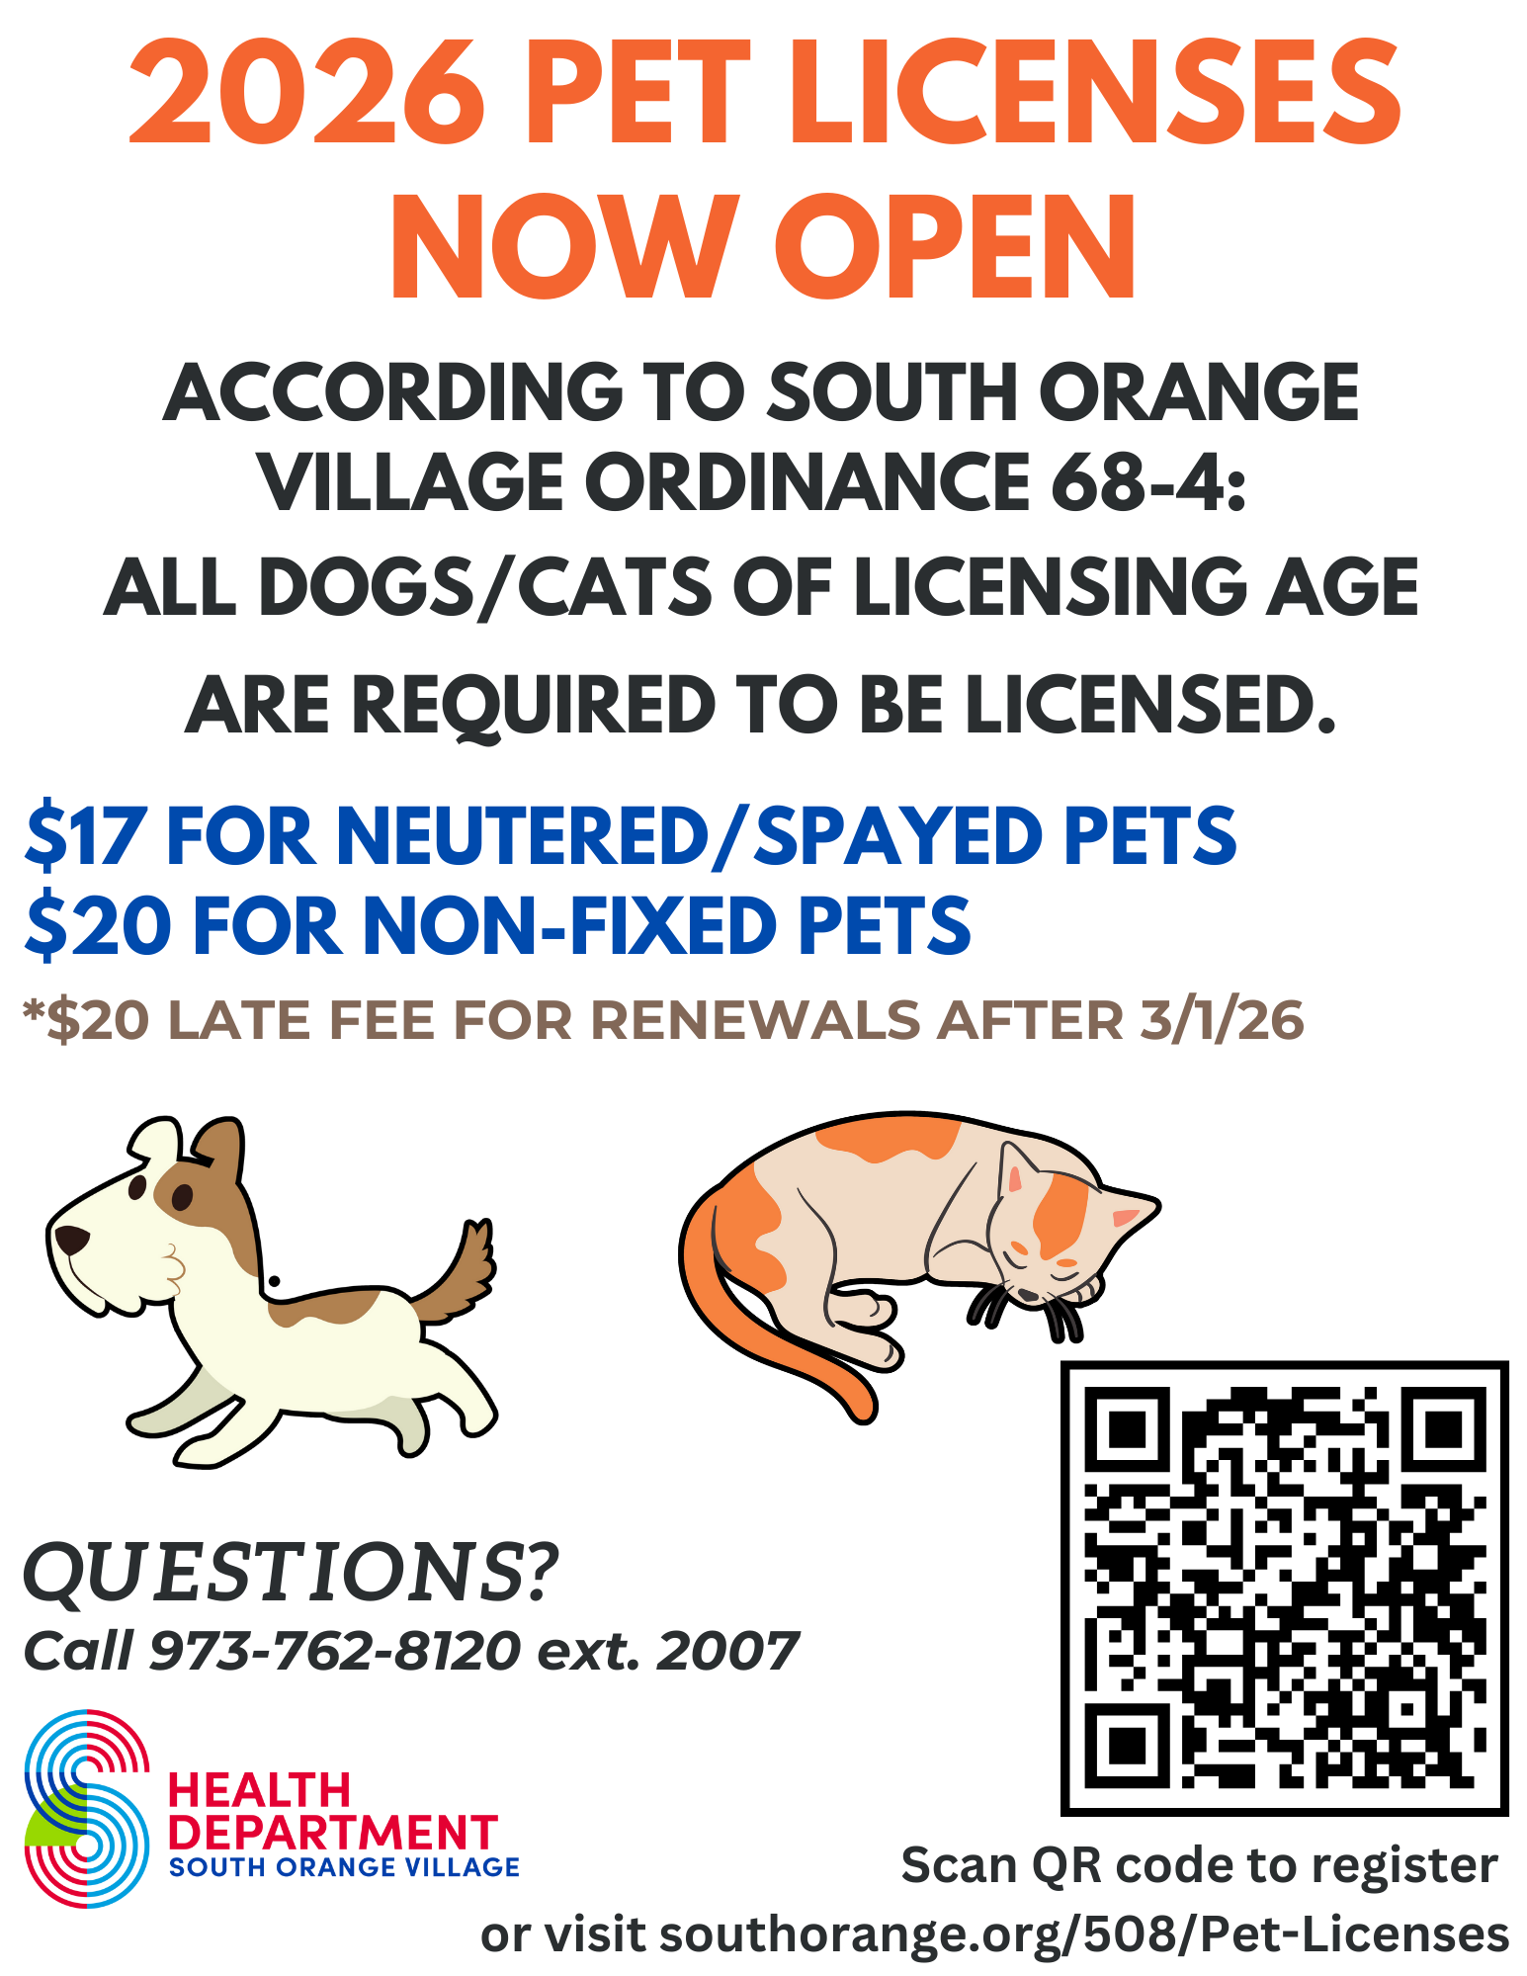

Slide 17
Social Services/Mental Health

Slide 18
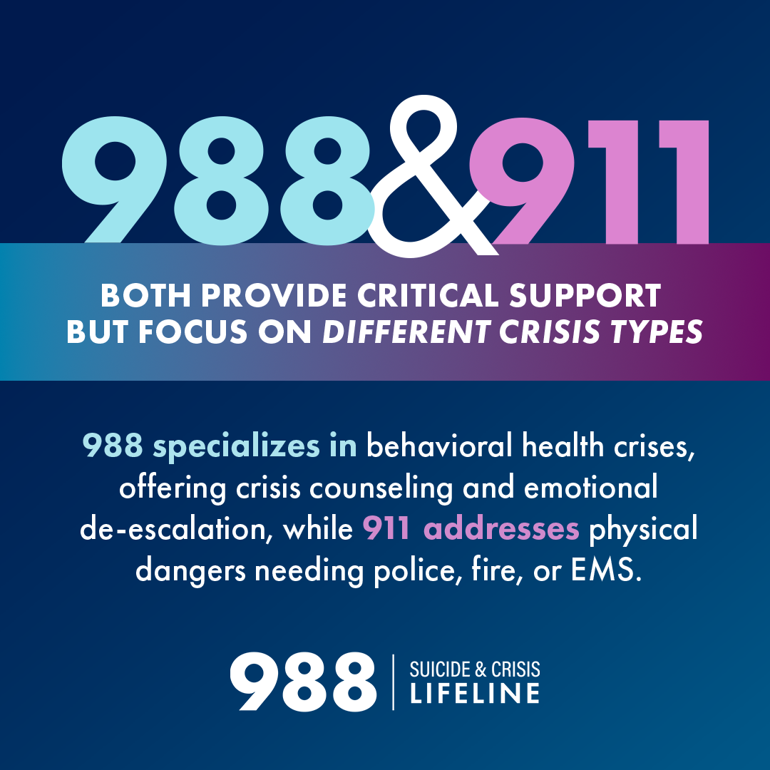

Slide 19
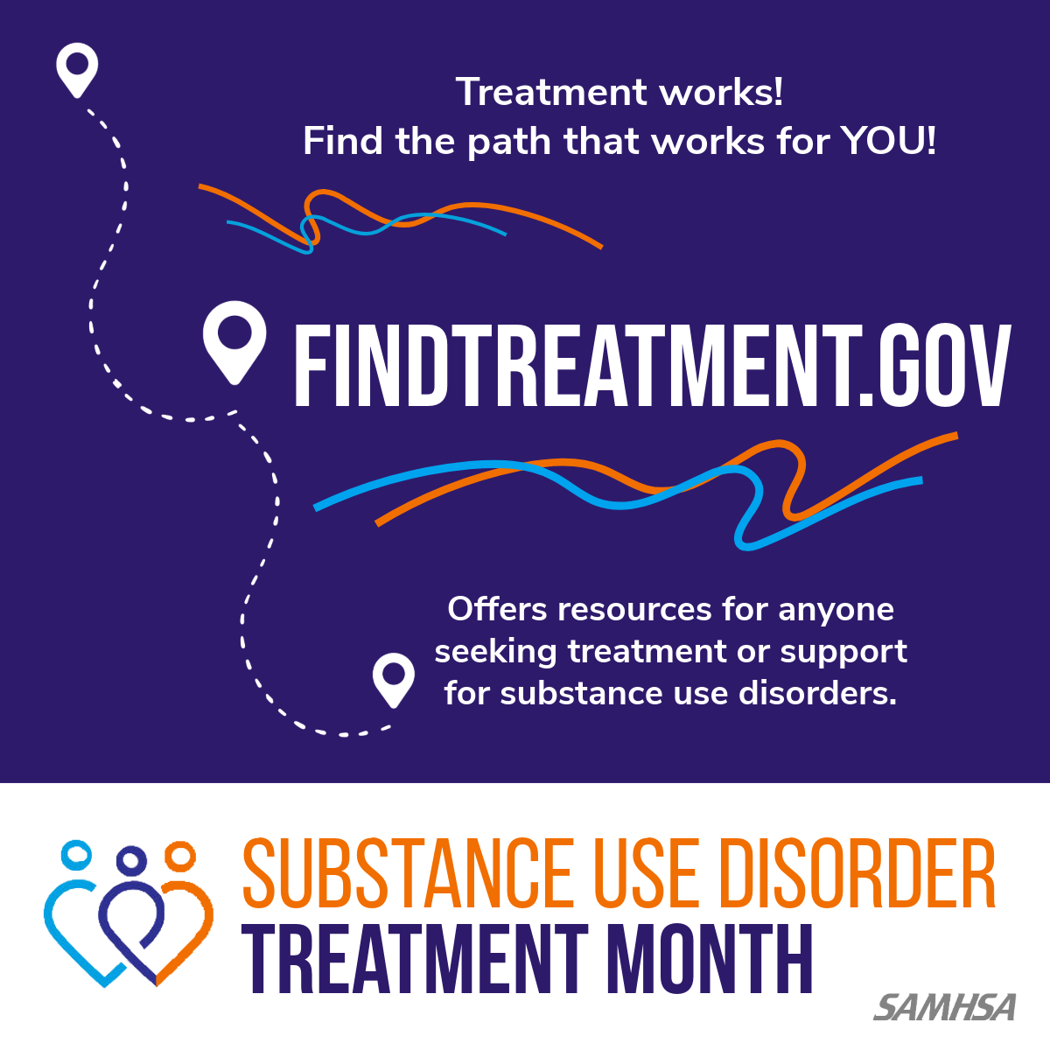

Slide 20
