Slide 1


Valley & Third Streets Redevelopment

Slide 2
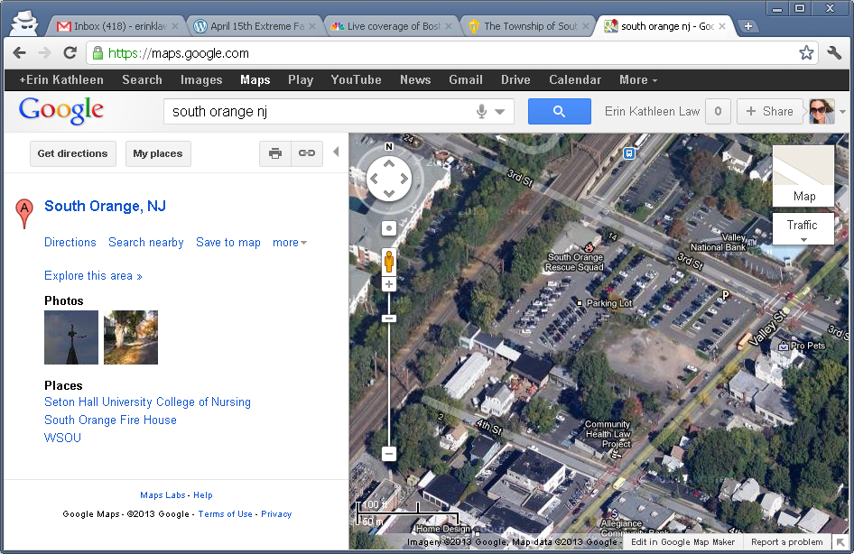
The Land
Block 2304, Lots 3-9, 2.7 acres (the “Property”)

Slide 3
History: Redevelopment Area Designation
February 27, 1995 | Trustees directed the Planning Board to determine whether certain properties meet the criteria for designation as “an area in need of redevelopment.”
December 4, 1995 | After public hearings, the Planning Board recommended that the Property (along with other blocks and lots in the Village) be designated as “an area in need of redevelopment.”
December 18, 1995 | Village designated certain properties, including the Property, “an area in need of redevelopment.”

Slide 4
History: Adoption of CBD Plan
April 22, 1996 | Trustees requested that the Planning Board prepare a redevelopment plan for the Property, among other blocks and lots.
November 25, 1996 | Trustees adopt the “Central Business District Redevelopment Plan” (the “CBD Plan”).
September 23, 2002 | Trustees adopted first amendment to the CBD Plan.
October 15, 2008 | Trustees adopted second amendment to the CBD Plan.

Slide 5
History: RFP Issuance and Response
February 24, 2011 | Village issued a request for qualifications for parties interested in developing the Property into a mixed use project with residential, retail and parking uses. Nine development teams presented their qualifications.
November, 2011 | Village issued a request for proposals to develop the Property.
March 31, 2011 | Village received two proposals, including a proposal from Jonathan Rose Companies, Inc. (“JRC”).
May 30, 2012 | Trustees authorized the execution of a Conditional Redevelopers Agreement by and between the Village and JRC.

Slide 6
History: Valley & Third Streets Plan
JRC’s proposal included residential rental units, retail space and a structured parking deck to serve both the public and building residents. In order to construct the project as proposed, the CBD Plan required amendment.
August 13, 2012 | Trustees requested that the Planning Board prepare a redevelopment plan for the Property.
November 14, 2012 | The Planning Board adopted a redevelopment plan for the Property and sent the same to the Trustees.
January 28, 2013 | After a public hearing the Trustees adopted the Valley and Third Streets Redevelopment Plan (the “Plan”).

Slide 7
The Project
Approximately 521 Space Structured Parking Facility (with 255 spaces allocated for public use). The Structured Parking Facility will be screened along Third St by residential elements.
Approximately 215 residential rental units (including 21 affordable housing units) with approximately 16 studio units, 116 one bedroom units, 81 two bedroom units and 2 three bedroom units.
3,000 square feet of retail space along Valley Street.
Building varies in height between 3 and 5 stories.
Transit-oriented development project that will provide additional customer base for downtown businesses.

Slide 8
Project Costs
Total Project Cost: $59.9 Million
Sources:
Redeveloper Equity: $17.7 Million
Debt: $41.9 Million
Other: $300,000 (New Jersey Green Funding Sources)
Uses:
Garage Construction: $10.4 Million
Mixed Use Construction: $35.1 Million
Soft Costs & Acquisition: $14.4 Million

Slide 9
Project Pro forma
Projected Monthly Market Rate Rents:
$1,580 Studio
$2,060 One Bedroom
$2,980 Two Bedroom
Total Estimated Annual Gross Revenues (Year 1):
$5.7 Million
Year One Unlevered Return on Investment:
6.2%

Slide 10
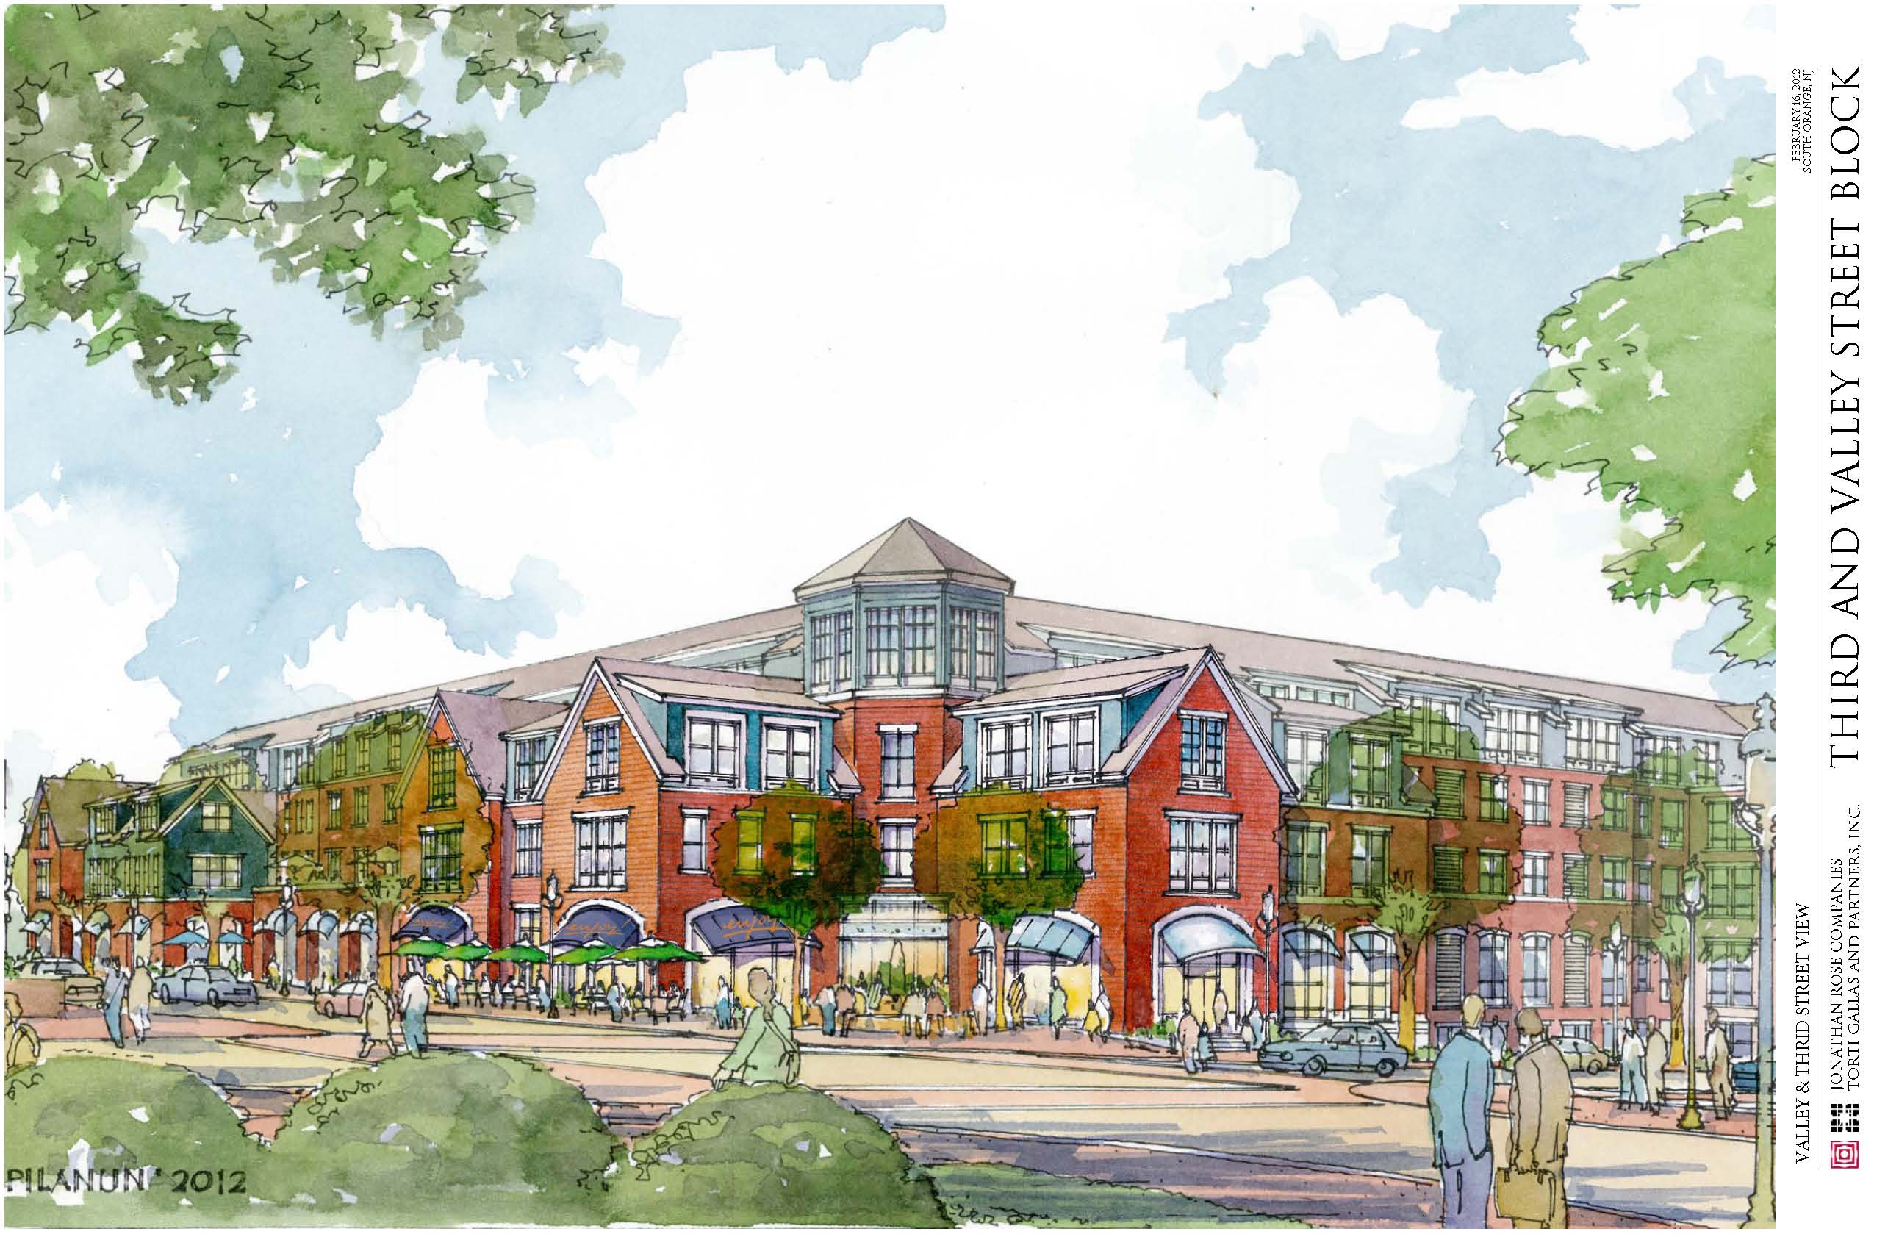
The Project

Slide 11
The Financial Agreement
Annual Service Charge (“ASC”) of approximately $570,000.
Village will retain 95%
County will receive the remaining 5%
The ASC is based on the annual gross revenues of the Project, which are currently estimated to be approximately $5.7 million in year one but will increase as rents increase.
30 year agreement (commencing the month following the issuance of a certificate of occupancy ).
Administrative fee of 1% of prior year’s ASC
Periodic reports and annual audits will be provided to the Village.

Slide 12
Total Value of Project to Village
Total Value: $37.24 Million
Annual Service Charge: $27.5 Million
Structured Parking Facility: $5.8 Million
Financial/Rescue Squad Contribution: $1.1 Million
Affordable Housing Trust Fund: $.44 Million
On Site Affordable Housing: $2.4 Million

Slide 13
The Redevelopment Agreement
Agreement describes the Project and development timeline
Requires LEED certification of the Project
Access Easement allows for the construction of a bike path by Township
Offsite Affordable Housing Payment of $440,000
Addresses relocation of Rescue Squad facility, and provides $1.1M payment to be used for relocation or any other purpose
Guarantees 255 public parking spaces through a Parking Agreement

Slide 14
Effective Sales Price Of Property
Total Compensation: $6.9 Million
Financial/Rescue Squad Contribution: $1.1 Million
Structured Parking Facility: $5.8 Million
Price per Residential Unit: $35,750
Price per Acre: $2.6 Million

Slide 15
Anticipated Project Development Timetable
July, 2013 | Site Plan Approval Obtained
October, 2013 | Commencement of Rescue Squad Construction
December, 2013 | Construction Documents Completed
March, 2014 | Finalize Loan Documents and Obtain Building Permits
April, 2014 | Closing on Sale of Property

Slide 16
Anticipated Project Development Timetable
June, 2014 | Completion of New Rescue Squad
June, 2014 | Commencement of Construction
July, 2015 | Completion of Structured Parking Facility
April, 2016 | Completion of Mixed Use Project

Slide 17
Temporary Parking
The Village has been in negotiations with several property owners for temporary parking.
Spaces will be provided in lots throughout the Village.
For spaces not in close proximity to the train station, the Village will add jitney routes, as needed.
JRC will pay $200,000 towards temporary parking

Slide 18
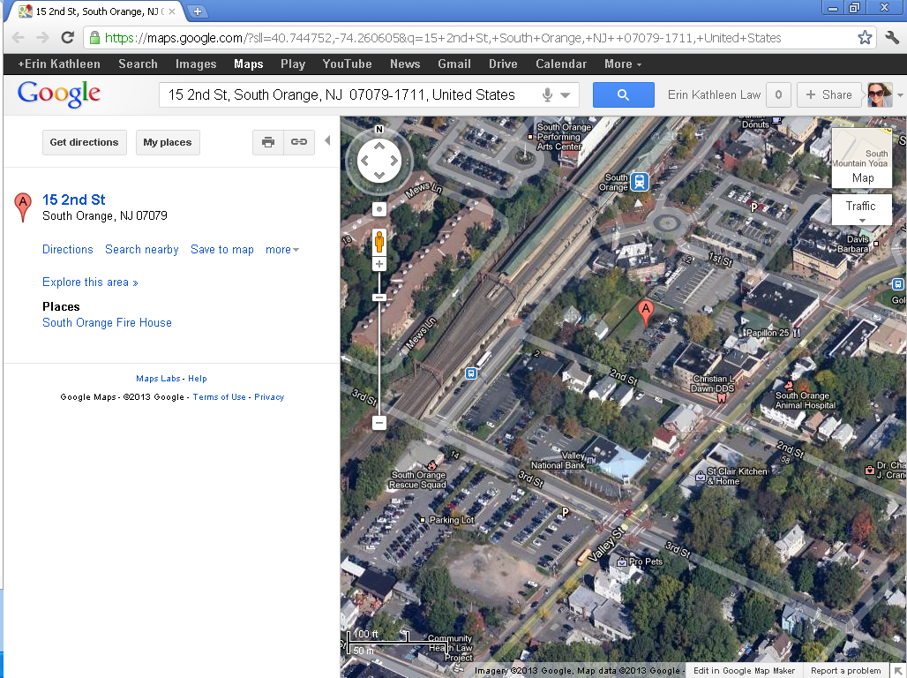
Proposed Rescue Squad Relocation

Slide 19
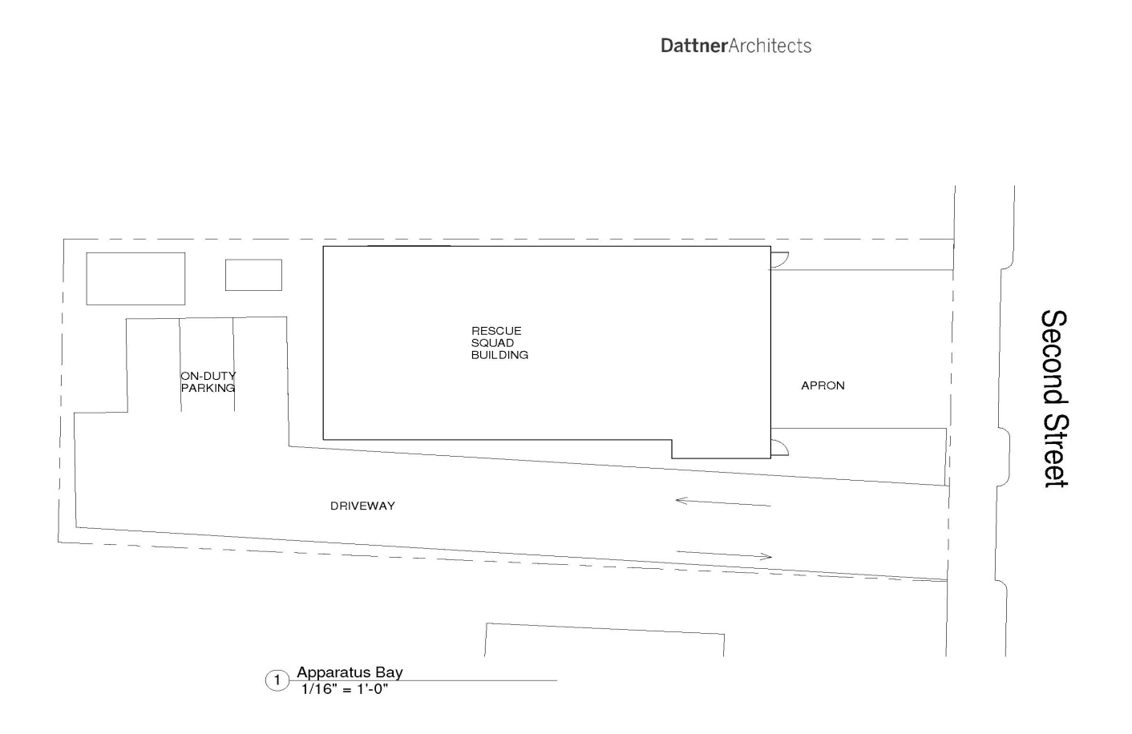
Rescue Squad Concept Plan

Slide 20
Proposed Features of New Rescue Squad Facility
First Floor
Ambulance bays with room for 3-4 vehicles
Storage area
Office
Second Floor
Public meeting room/shelter for emergencies and bath room
Kitchen and Rescue Squad common area
Bedrooms for overnight shifts
Full bathroom with shower facility
Exterior
Rescue Squad parking (onsite and offsite)
Generator
Storage

Slide 21
Next Steps
Prepare and adopt redevelopment plan for Rescue Squad site
Negotiate and authorize rescue squad construction agreement
Finalize temporary parking arrangements; obtain Trustee approval as applicable
Negotiate and authorize public parking agreement
Prepare and adopt bond ordinance as standby for Rescue Squad costs
Clear title issues and relocate electric wires

