Slide 1
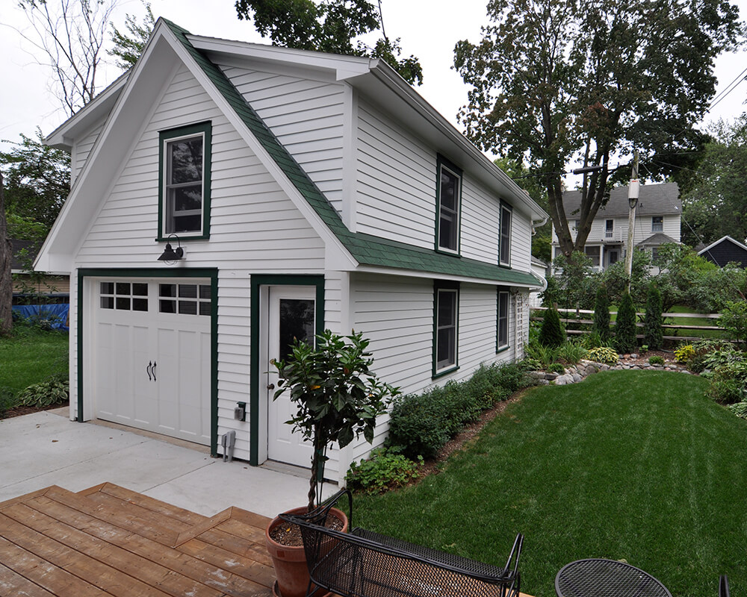

Accessory Dwelling Units
Prepared For:
Village of South Orange Board of Trustees
Prepared By:
September 12, 2022
Notes:
Change pic with white ADU

Slide 2
Agenda
Context
Review of Proposed Ordinance
Frequently Asked Questions

Slide 3
Pros + Cons of Accessory Dwelling Units
Pros:
Consistent with Master Plan; received broad community support during Master Plan process
Helps diversify the housing stock and provide a range of housing options
Creates housing opportunities for community seniors to remain in their home or reside in an ADU
Creates access to housing for broader socioeconomic groups
Repurpose existing accessory structures for more usable space
Increased property value and/or income for property owner
Increased tax revenue for Village
Cons:
Increased property tax
Cost of construction and utilities
Requires maintenance
Loss of storage space
Possible disruption of privacy of primary dwelling occupant and/or neighbors

Slide 4
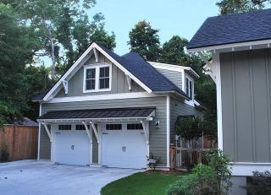
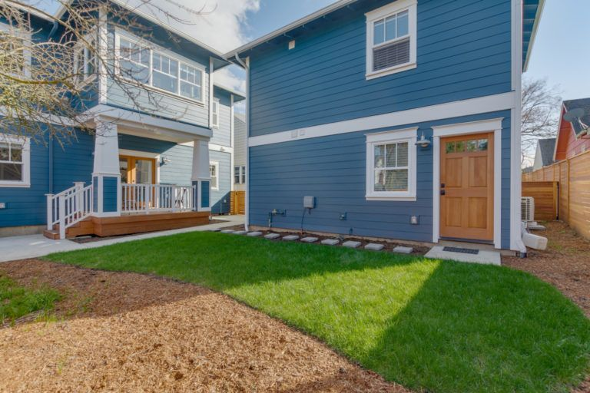
Context
Proposed Ordinance Definition: “A self-contained portion of a principal, one-family dwelling, two-family dwelling, or an accessory structure, used as a secondary housing unit independent of the primary dwelling unit, that can only be used as a residence for occupancy by one family/housekeeping unit for 90 days or greater, on the same lot as a one or two-family dwelling where the owner lives on site, that is smaller in size and height than the principal building on the lot that serves as a dwelling unit. (See “Dwelling Unit” definition in §185-3). For the avoidance of confusion and by way of illustration, the addition of an accessory dwelling unit to a lot on which a single family dwelling exists shall cause such lot, for all subsequent purposes, to be considered, classified and assessed as a two-family lot (and such calculation shall progress accordingly).”
What is an ADU?

Slide 5
Context
Breakdown of Definition
Self-contained portion of a principal, one-family dwelling, two-family dwelling,
or an accessory structure,
used as a secondary housing unit independent of the primary dwelling unit,
that can only be used as a residence for occupancy by one family/housekeeping unit for 90 days or greater,
on the same lot as a one or two-family dwelling where the owner lives on site,
that is smaller in size and height than the principal building on the lot that serves as a dwelling unit. (See “Dwelling Unit” definition in §185-3).
For the avoidance of confusion and by way of illustration, the addition of an accessory dwelling unit to a lot on which a single family dwelling exists shall cause such lot, for all subsequent purposes, to be considered, classified and assessed as a two-family lot (and such calculation shall progress accordingly).”

Slide 6
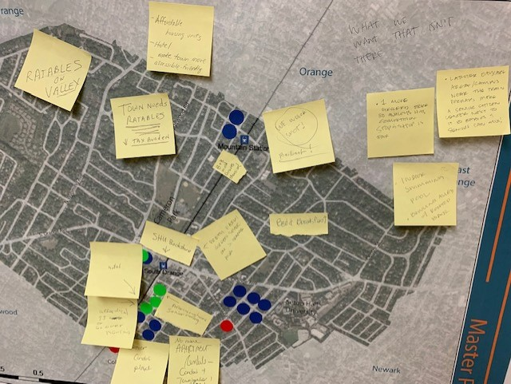
Context
The Process
The Village received feedback from the public during the Master Plan process that greatly indicated public support for Accessory Dwelling Units (ADU).

Slide 7
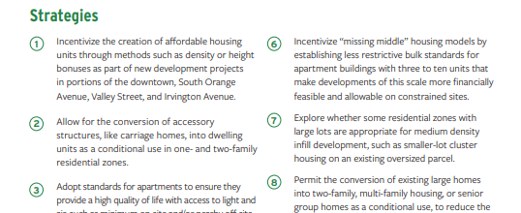
Context
Master Plan Page 128

Slide 8
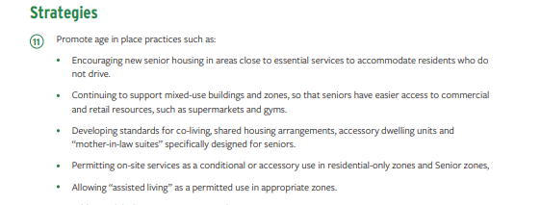
Context
Master Plan Page 129

Slide 9
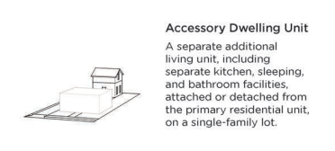
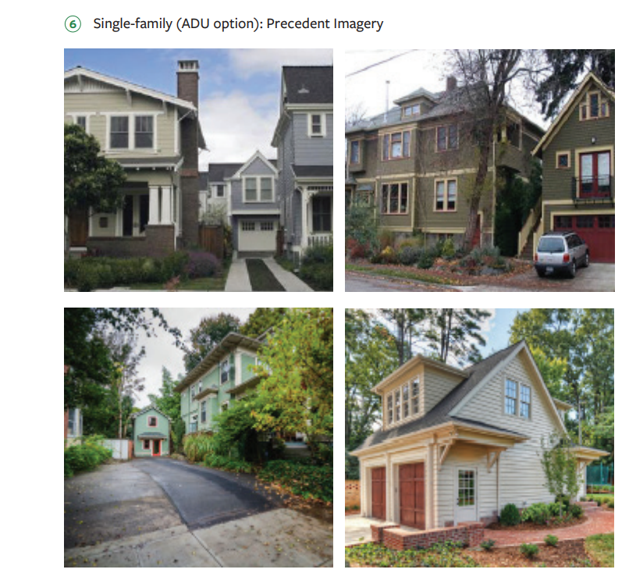
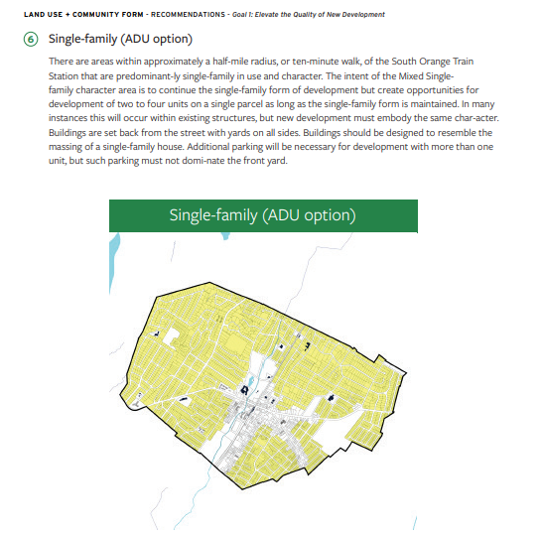
Context
Master Plan Pages 99 +100

Slide 10
Context
The Process
The Planning and Economic Development Committee worked to develop standards for the permitting of ADUs in certain places and under certain conditions based on zone, lot size, and lot suitability.
These standards have been reviewed by the Village Attorney, Planning Board Attorney, and Zoning Board Attorney for legal compliance, the Village’s Building and Engineering Departments for their professional input, and were also shared with the Historic Preservation Commission and Senior Advisory Committee. All feedback has been incorporated.

Slide 11
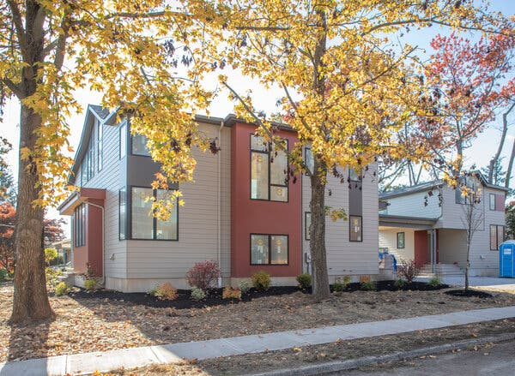
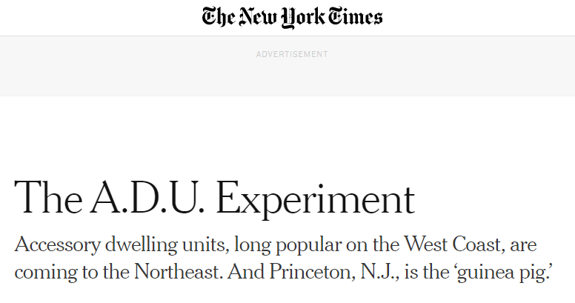
Context
Local Precedents
Maplewood and Princeton recently adopted similar ADU Ordinances
A new house with an associated ADU being built in Princeton courtesy of the New York Times.

Slide 12
Review of Proposed Ordinance
Proposed Ordinance Content
The Ordinance permits accessory dwelling units on lots that contain a detached single- or two-family dwelling in the Residential RA-50, RA-60, RA-75, RA-100, and RB zones.
Design standards require that the ADU will complement the primary dwelling, with requirements for consistent materials, colors, and roof designs.
The Ordinance regulates location and intensity of ADUs, such as maximum accessory dwelling unit size as well as setback and coverage requirements to allow for proper buffering, landscaping, light and air, and to minimize impact to adjacent properties.
The Ordinance requires parking for ADUs to be provided on site and does not permit off site parking. Where parking for the ADU cannot be provided on site, the lot is not permitted to accommodate an ADU.

Slide 13
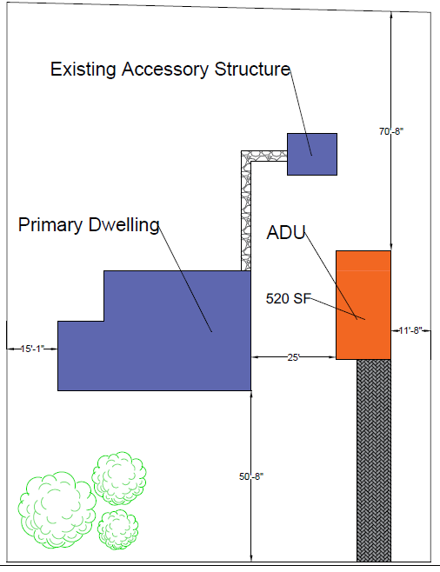
Review of Ordinance
Example bulk chart per RA-60 standards and proposed ADU standards
Existing lot with a single car garage converted to ADU in a compliant configuration
Standard | Required
Lot Area (Min.) | 6000 SF
Lot Width (Min.) | 110’
Front Yard Setback (Min.) | 25’
Side Yard Setback – (Min.) | 10.4’
Rear Yard Setback – (Min.) | 16’
Lot Coverage (Max.) | 40%
Building Height (Max.) | 2.5 Stories/ 35’
Accessory Structure Height (Max.) | 25’
ADU Size | Min. 350 SF Max. 750 SF
Max. Rear Yard Accessory Coverage | 30%
Min. ADU Parking | 1 Off-street space
Max. Driveway Width | 10’ With Single Car Garage

Slide 14
Review of Proposed Ordinance
Review of Ordinance
Proposed Ordinance Content
Additional Ordinance sections are clarified and reconciled.
This includes:
Delineation between types of accessory structures (i.e. gazebo versus an ADU versus a garage, etc.)
Definition between long term- versus short term- rentals (i.e. ADUs are not for Airbnb's)
Updates to other parts of the code (i.e. home-based businesses) for consistency with the new accessory use requirements discussed herein

Slide 15
Review of Proposed Ordinance
Review of Ordinance
Proposed Ordinance Content
Procedure:
Applicants who comply with the requirements of the ordinance can seek permits through the zoning and building office.
Applicants who don’t comply with the requirements of the ordinance will require bulk and/or use variance approval from the Zoning Board.

Slide 16
Frequently Asked Questions
Question: Will converting basements into ADUs be allowed?
Answer: No, after careful review, it was determined that basements will not provide the necessary quality of living and environment that is intended to be associated with an ADU.
Question: Why is there an off-street parking requirement for ADUs?
Answer: The off-street parking requirement will help ensure that ADUs will only be built on lots that are suitable and can comfortably accommodate the additional dwelling while not overburdening on-street parking.
Question: Will ADUs be permitted within all zones in the Village?
Answer: No, they will only be permitted in the single- and two-family districts in sites that contain a single- or two-family dwelling.
Question: Will an ADU on a lot increase property taxes?
Answer: Yes, ADUs have the potential to raise property taxes. The extent of which will vary on the type and scope of improvements.

Slide 17
Frequently Asked Questions
Question: Can there be more than 1 ADU on a lot?
Answer: No, there is a maximum of 1 ADU per lot.
Question: Can ADUs be used as Airbnb's ?
Answer: No, that is not permitted. The intent of the Ordinance is to provide for additional longer-term housing in the Village. Therefore, the definition for an ADU specifies an occupancy time of 90 days or greater.
Question: Why does the proposed ordinance appear very restrictive and how practical is it for an ADU to get developed?
Answer: The intent is to permit the development of ADUs on sites most appropriate to accommodate them (i.e. sufficient size, has off-street parking, etc.) The Village will continually monitor the development of ADUs to identify whether modifications or updates to these standards are necessary.

Slide 18
Thank You!
Questions?

