Slide 1
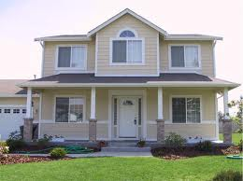
THE REVALUATIONS OF MAPLEWOOD & SOUTH ORANGE VILLAGE TOWNSHIP
Questions That Are Often Asked When
A Municipality Is Undertaking A Revaluation

Slide 2
WHAT IS A REVALUATION?
A revaluation is a program undertaken by a municipality to appraise all real property at its fair market value
The goal of a revaluation program is to ensure the tax burden is equitably distrubuted throughout a municipality

Slide 3
WHAT IS MEANT BY “FAIR MARKET VALUE?”
Fair market value is the price at which the municipal assessor believes a property would sell for at a fair and bona fide sale by a private contract on October 1 of the pretax year

Slide 4
WHY REVALUE NOW?
A revaluation is warranted when properties in a taxing district are being assessed substantially below or above true market value
The average property in Maplewood Township is assessed at 77.90% of market value for 2022.
The average property in South Orange Village Township is assessed at 77.11% of market value for 2022
The last Revaluation/Reassessment in Maplewood and South Orange occurred 2017.

Slide 5
WHO WILL CONDUCT THE REVALUATION?
The Townships have entered into an agreement with Professional Property Appraisers, Incorporated to perform both township-wide revaluations.

Slide 6
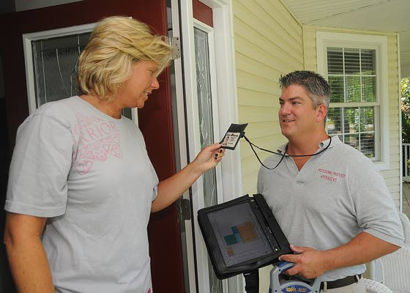
FIELD REPRESENTATIVES
Each data collector will have a photo identification badge visibly displayed. It will show the company’s name, Professional Property Appraisers as well as the individual’s name
The inspector can provide a letter of introduction on municipal letterhead that contains a telephone number for questions or concerns
Ask to see the credentials of anyone seeking to enter your home and do not admit anyone who cannot produce this identification

Slide 7
WHAT OCCURS DURING THE REVALUATION PROCESS?
Interiors and exteriors of each property are physically inspected and building dimensions are noted
The exterior of the property will be photographed
Recent sales of comparable properties are analyzed and will be adjusted to estimate the value of the property that has not been sold
Commercial property, typically purchased for investment purposes, is studied in terms of its income-producing capability
All information believed to influence value will be gathered, reviewed and analyzed

Slide 8
WHAT IS EXPECTED OF PROPERTY OWNERS?
Interior inspections, especially, require that residents cooperate with data collectors
The validity of a market value depends on the collection of accurate data
Any assistance a taxpayer can provide will aid in the total data collection process. If there is information you believe should be considered in the valuation, please inform the data collector. We will make every effort to cause property owners the least possible inconvenience
Remember, the data collectors are not necessarily responsible for developing the market value estimate. Their job is usually to collect pertinent information to be used later as a base to develop the property’s value

Slide 9
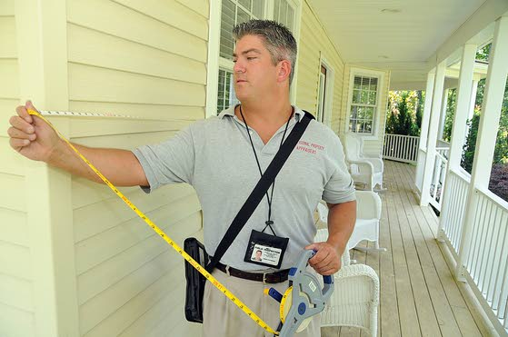
WHAT WILL DATA COLLECTORS LOOK FOR?
Data collectors will record such items as: condition, number of bathrooms, type of heat, central air conditioning, size and percentage of finished attic and/or basement areas, and number of fireplaces
The exterior inspection includes measurements of each structure, such as: garages, in-ground pools or other accessory buildings
Examples of what would not be noted are interior decorations, fences, window air conditioners, gas grills and landscaping, etc.

Slide 10
WHAT IF I'M NOT HOME?
Upon initial visit, a notice will be left with a return date, time and the Inspector’s Name and ID Number
Upon second attempt a notice will be left asking you to call for an appointment
Appointments can be scheduled on weekdays, evenings as well as Saturdays if need be.
If the representative is unable to inspect your home, the interior information will be estimated

Slide 11
WILL MY TAXES GO UP?
Although the revaluation will result in a change of nearly all individual assessed values, it does not mean that all property tax burdens will change.
The tax rate will be adjusted in 2024 to compensate for the change in the assessed values
Since not all properties have appreciated in value at the same rate, some tax levies will go up, some will stay about the same and others will go down

Slide 12
WILL TAXPAYERS BE INFORMED OF THEIR PROPOSED ASSESSMENT?
A notice of the new assessed values for each property will be mailed in the fall of 2023
The impact of the new assessments will not affect the property owner’s tax bill until the 2024 tax year

Slide 13
WHAT IF A TAXPAYER IS DISSATISFIED WITH THE PROPOSED ASSESSMENT?
The notice of your new 2024 assessed value will explain how to arrange for a personal informal meeting with a representative from Professional Property Appraisers to review the proposed assessment
Taxpayers attending the review should be prepared to support any disagreement regarding the assessed value of their property
For example, recent sales of similar or comparable properties or incorrect data about the home (i.e., number of bathrooms)

Slide 14

WHAT CAN A TAXPAYER DO IF HE OR SHE IS NOT SATISFIED AS A RESULT OF THE INFORMAL MEETING?
If for any reason a taxpayer is not satisfied with his or her assessed value for any given year, the taxpayer has the right to file a formal appeal with the Union County Board of Taxation on or before April 1st of that given year (Extended to May 1st for the first year after the revaluation)

Slide 15
Contact Information
Professional Property Appraisers, Inc. Toll Free: 1-866-957-1388
Website: ppareval.com

